Slide 1
LESSON LD02
The Model Rocket

Slide 2
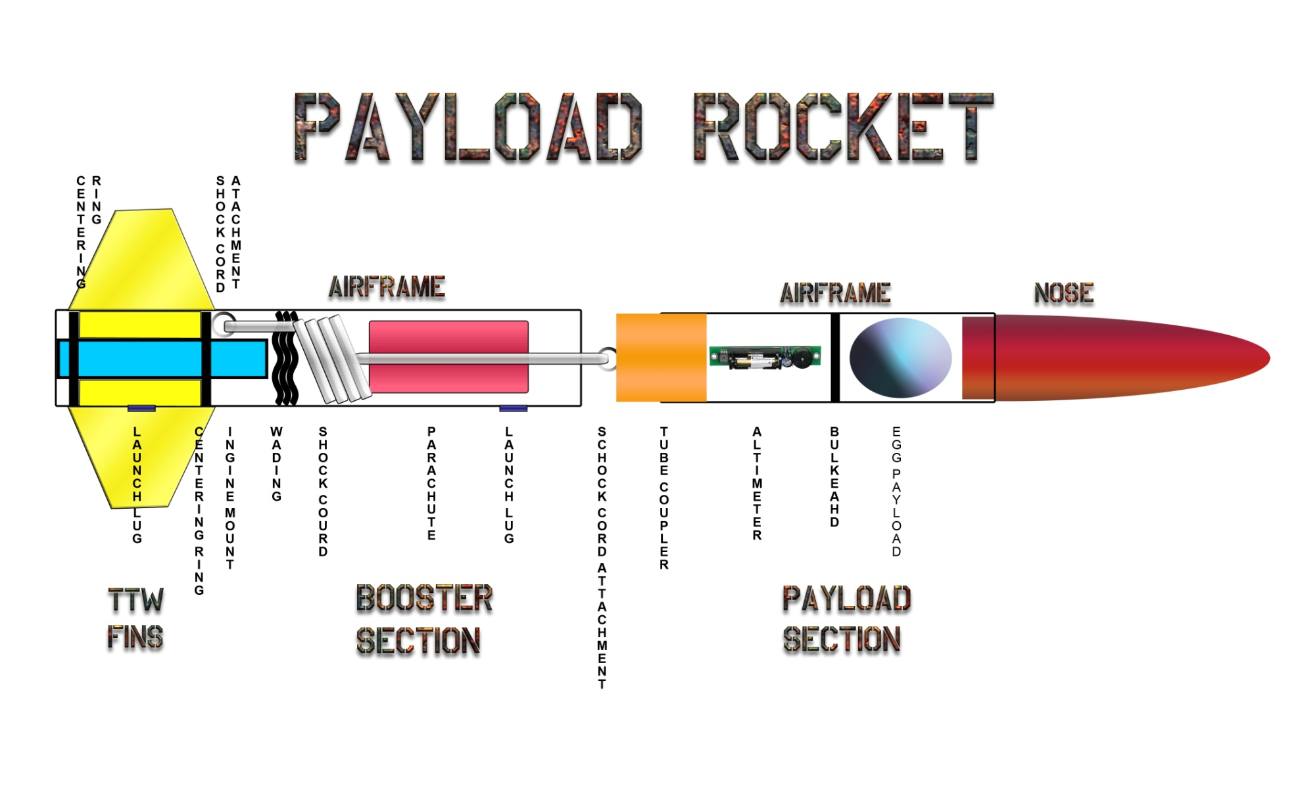
Notes:
Diagram of a typical payload carrying model rocket

Slide 3
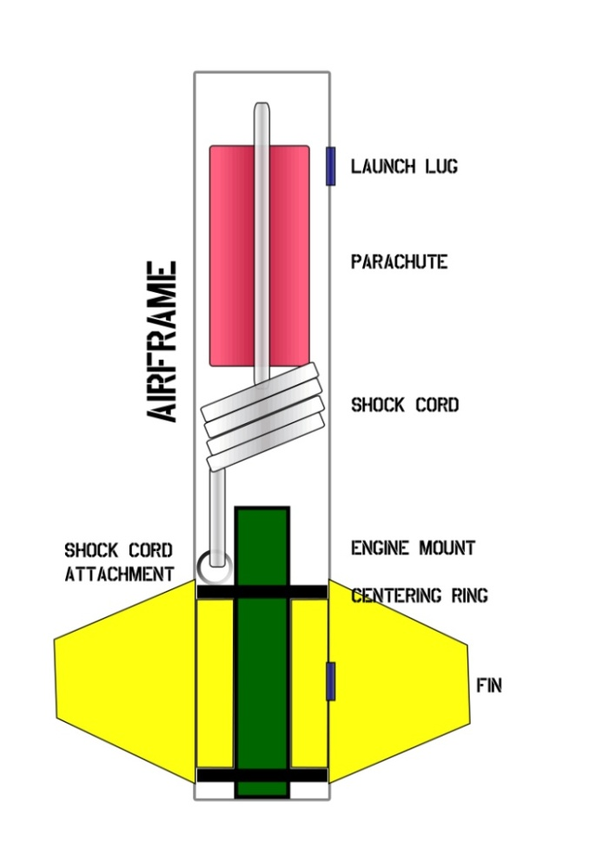
Booster
Section
Launch Lug – helps to guide the rocket upward until it reaches enough velocity for the fins to engage.
Parachute – assists in the safe recovery of the rocket.
Shock Cord – connects the parachute and nosecone to the booster. It absorbs the shock of ejection charge.
Shock Cord Attachment – attaches the shock cord to the booster section.
Centering Rings – attach the engine mount (and sometimes the fins) to the airframe.
Engine Mount – holds the rocket engine inside the rocket.
Engine Retainer – prevents the engine from being ejected by the ejection charge.
Fins – guides the rocket in a straight path.
Notes:
Booster Section
Launch Lug – helps to guide the rocket upward until it reaches enough velocity for the fins to engage.
Parachute – assists in the safe recovery of the rocket.
Shock Cord – connects the parachute and nosecone to the booster. It absorbs the shock of ejection charge.
Shock Cord Attachment – attaches the shock cord to the booster section.
Centering Rings – attach the engine mount (and sometimes the fins) to the airframe.
Engine Mount – holds the rocket engine inside the rocket.
Engine Retainer – prevents the engine from being ejected by the ejection charge.
Fins – guides the rocket in a straight path.

Slide 4
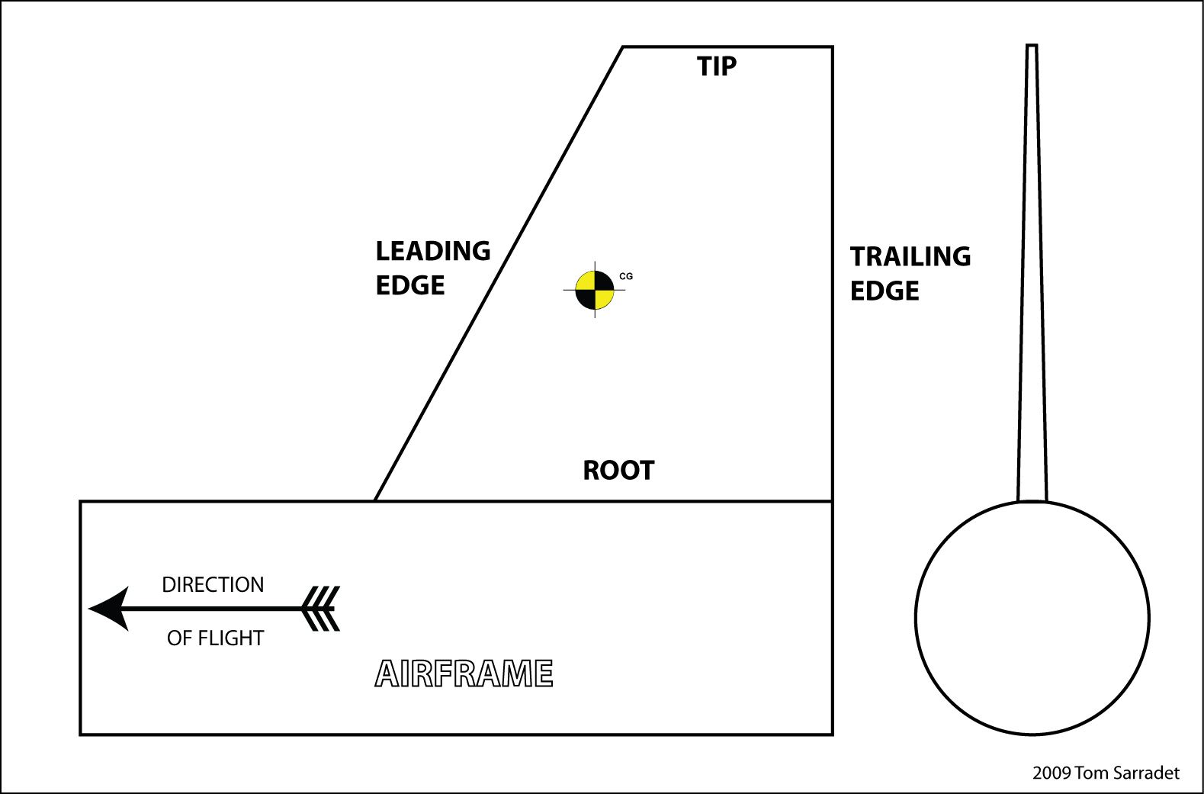
The Fin
Notes:
Parts of a rocket fin:
Leading edge
Tip
Trailing edge
Root

Slide 5
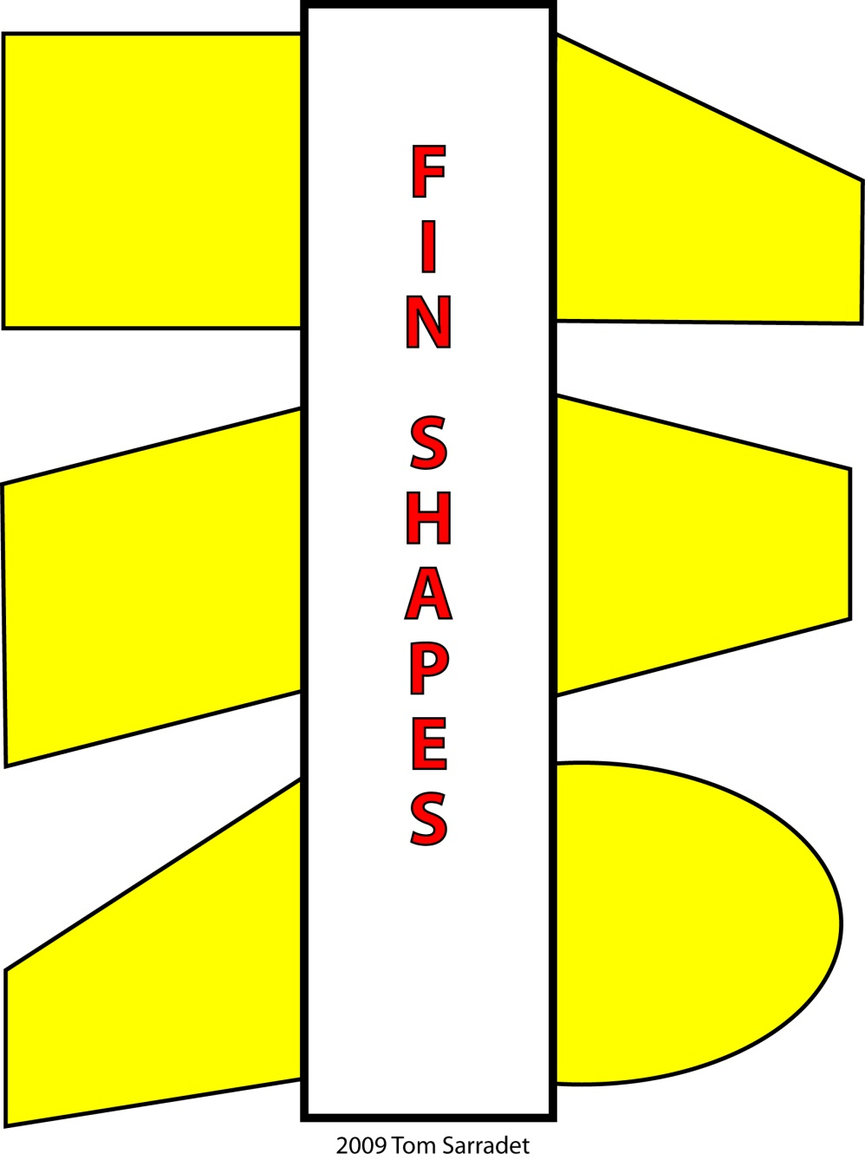
RECTANGULAR
Simple to make, least aerodynamic
CLIPPED DELTA
Good aerodynamic fin, used on low-drag, high-performance rockets
SWEPT
Simple to make, slightly better aerodynamics
TRAPEZOIDAL
Good aerodynamic fin for payload rockets, moves the Center of Pressure forward.
TAPERED SWEPT
Moves Center of Pressure back, good design for fast moving rockets.
ELLIPTICAL
Best aerodynamic fin, difficult to construct.
Notes:
Fin Shapes:
Rectangular: Simple to make, least aerodynamic
Swept: Simple to make, slightly better aerodynamics
Tapered Swept: Moves Center of Pressure back, good design for fast moving rockets.
Clipped Delta: Good aerodynamic fin, used on low-drag, high-performance rockets
Trapezoidal: Good aerodynamic fin for payload rockets, moves the Center of Pressure forward.
Elliptical: Best aerodynamic fin, difficult to construct.

Slide 6
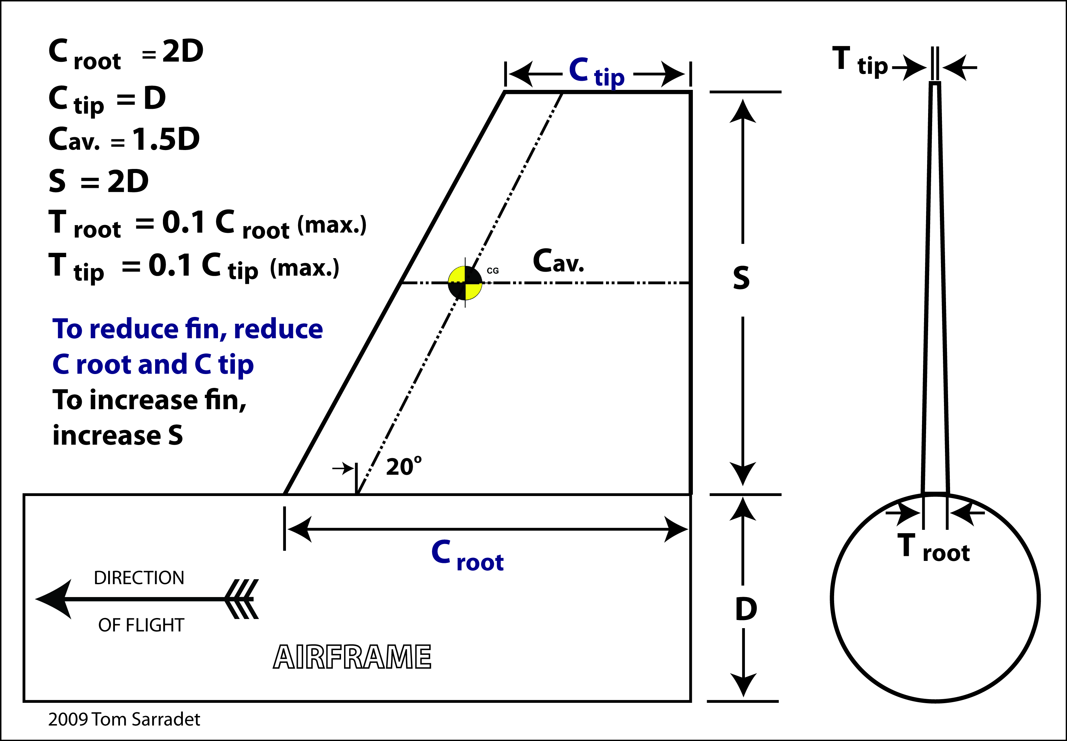
The Fin: Low Drag Design
Notes:
Low Drag Clipped Delta Fin
To determine the dimensions of a low drag fin:
Determine the diameter of the airframe.
Multiply it by 2 to determine the root length and the span (C _{root} and S)
The length of the tip (C _{tip}) is equal to the airframe diameter.
The thickness of the fin at the root (T _{root}) = 0.1 of the root length (C _{root}).
The thickness of the fin at the tip (C _{tip}) = 0.1 of the tip length (C _{tip})
To reduce the fin, reduce the C root and C tip only.
To increase the fin, increase the span (S) only.

Slide 7
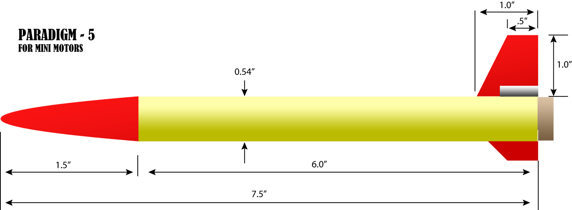
Low Drag, High Performance Rocket
The Paradigm–5 is an example of a low-drag, high performance model rocket design that uses a low-drag clipped delta fin.
Notes:
Low Drag, High Performance Rocket
The Paradigm–5 is an example of a low-drag, high performance model rocket design that uses a low-drag clipped delta fin.

Slide 8
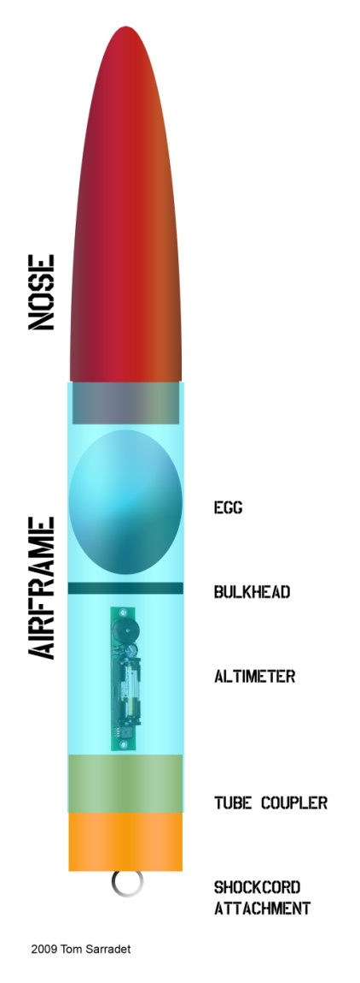
Payload Section
Nose – creates an aerodynamic shape. May also hold a payload.
Airframe – holds the payloads in place.
Bulkhead – separates the egg section from the electronics section, preventing vortex effect and causing a false altimeter reading.
Altimeter – measures the changing air pressure to calculate apogee. Must have vent holes in airframe in order to operate properly.
Tube Coupler – connects the payload section to the booster section by means of the shock cord. Also protects the payload from the ejection gases.
Shock Cord Attachment – a metal eye for the secure attachment of the shock cord.
Notes:
Payload Section
Nose – creates an aerodynamic shape. May also hold a payload.
Airframe – holds the payloads in place.
Bulkhead – separates the egg section from the electronics section, preventing vortex effect and causing a false altimeter reading.
Altimeter – measures the changing air pressure to calculate apogee. Must have vent holes in airframe in order to operate properly.
Tube Coupler – connects the payload section to the booster section by means of the shock cord. Also protects the payload from the ejection gases.
Shock Cord Attachment – a metal eye for the secure attachment of the shock cord.

Slide 9
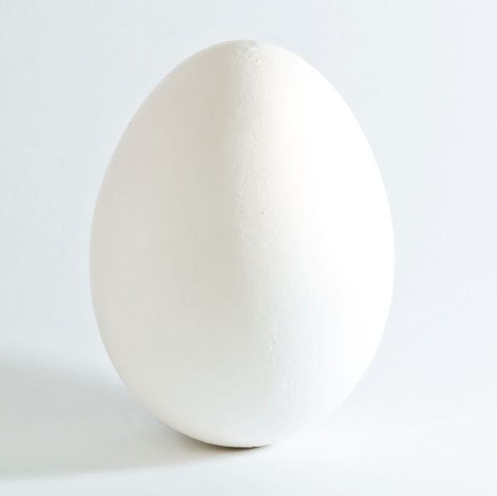
The Egg
Eggs have an ‘arch structure’ at each end that transfers pressure to the sides.
About 35 Newtons of force is required to break an egg on its end and about 25N to break it on its side.
Notes:
The Egg
Eggs have an ‘arch structure’ at each end that transfers pressure to the sides.
About 35 Newtons of force is required to break an egg on its end and about 25N to break it on its side.

Slide 10
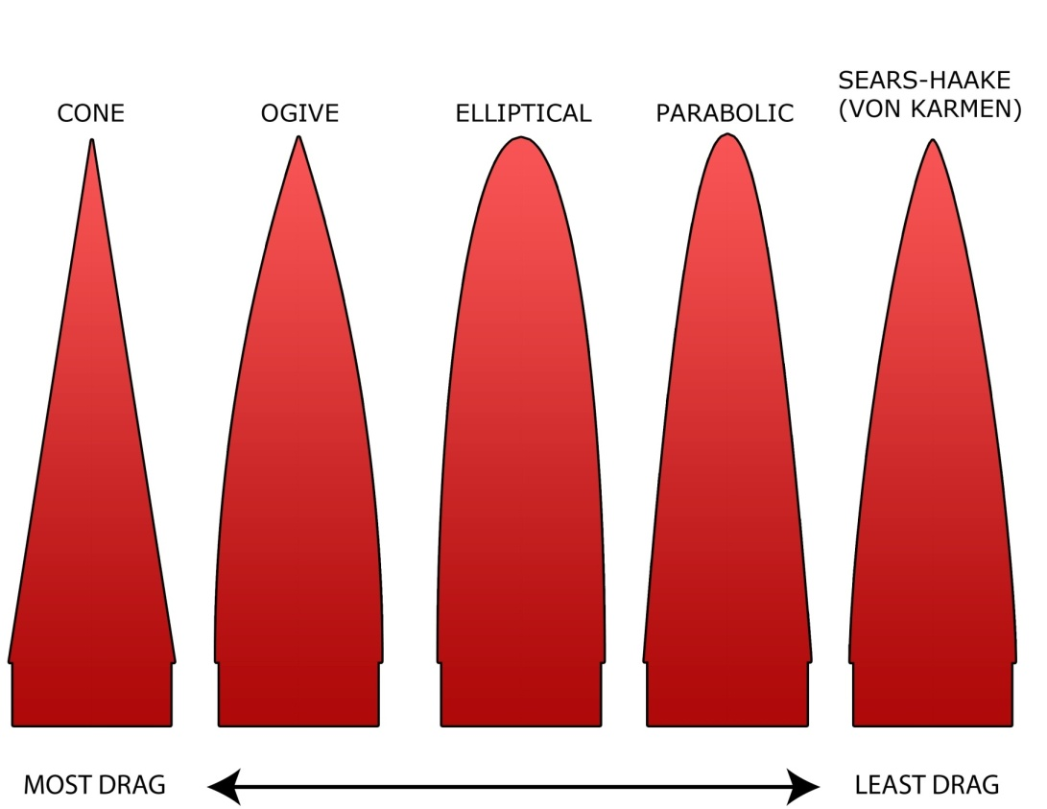
Nose Shape
Rocket noses are balsa, plastic, or fiberglass.
For aircraft and rockets, below Mach .8, the nose pressure drag is essentially zero for all shapes and the major significant factor is friction drag.
Having a smooth finish on the nose is more important than nose shape for rockets flying under the speed of sound.
Notes:
The Nose
Rocket noses are balsa, plastic, or fiberglass.
For aircraft and rockets, below Mach .8, the nose pressure drag is essentially zero for all shapes and the major significant factor is friction drag.
Having a smooth finish on the nose is more important than nose shape for rockets flying under the speed of sound.

Slide 11
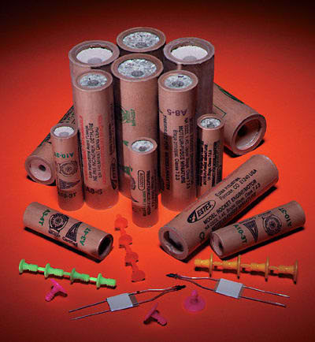
Rocket Motors

Slide 12
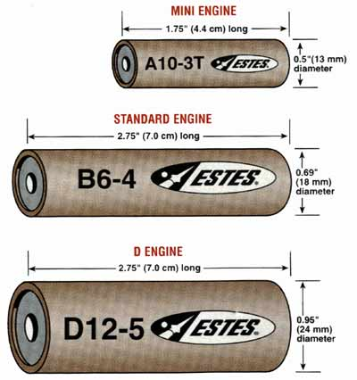
Motor Sizes
Motor diameter is measured in millimeters.
Sizes for low to mid-power rockets are 13mm, 18mm, 24mm, and 29mm.
Notes:
Motor Sizes
Motor diameter is measured in millimeters.
Sizes for low to mid-power rockets are 13mm, 18mm, 24mm, and 29mm.

Slide 13
Engine or Motor?
Something that imparts motion is called a motor.
An engine is a machine that converts energy into mechanical motion.
While referring to the propulsion system of a model rocket as a motor is more accurate, the use of the term engine is common.
Notes:
Engine or Motor?
Something that imparts motion is called a motor.
An engine is a machine that converts energy into mechanical motion.
While referring to the propulsion system of a model rocket as a motor is more accurate, the use of the term engine is common.

Slide 14
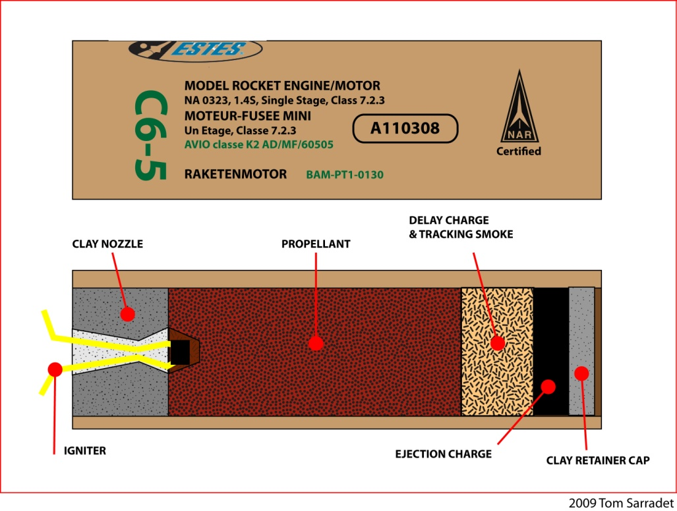
Black
Powder
Motor
B – The letter indicates the total impulse power produced by the motor. Each letter doubles the power.
6 – The first number gives the average thrust of the motor in Newtons.
4 – The last number indicates the delay seconds between the end of thrust and the ejection charge.
Notes:
Black Powder Motor
B – The letter indicates the total impulse power produced by the motor. Each letter doubles the power.
6 – The first number gives the average thrust of the motor in Newtons.
4 – The last number indicates the delay seconds between the end of thrust and the ejection charge.

Slide 15
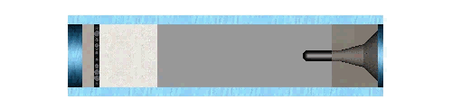
Black Powder Motor Burn
Black powder motors burn from the rear forward.
When the propellant is spent, it ignites the delay charge.
The delay charge burns forward and ignites the ejection charge.
The clay nozzle forces the pressure forward, expelling the nose cone and recovery system.
Notes:
Black Powder Motor Burn
Black powder motors burn from the rear forward.
When the propellant is spent, it ignites the delay charge.
The delay charge burns forward and ignites the ejection charge.
The clay nozzle forces the pressure forward, expelling the nose cone and recovery system.

Slide 16
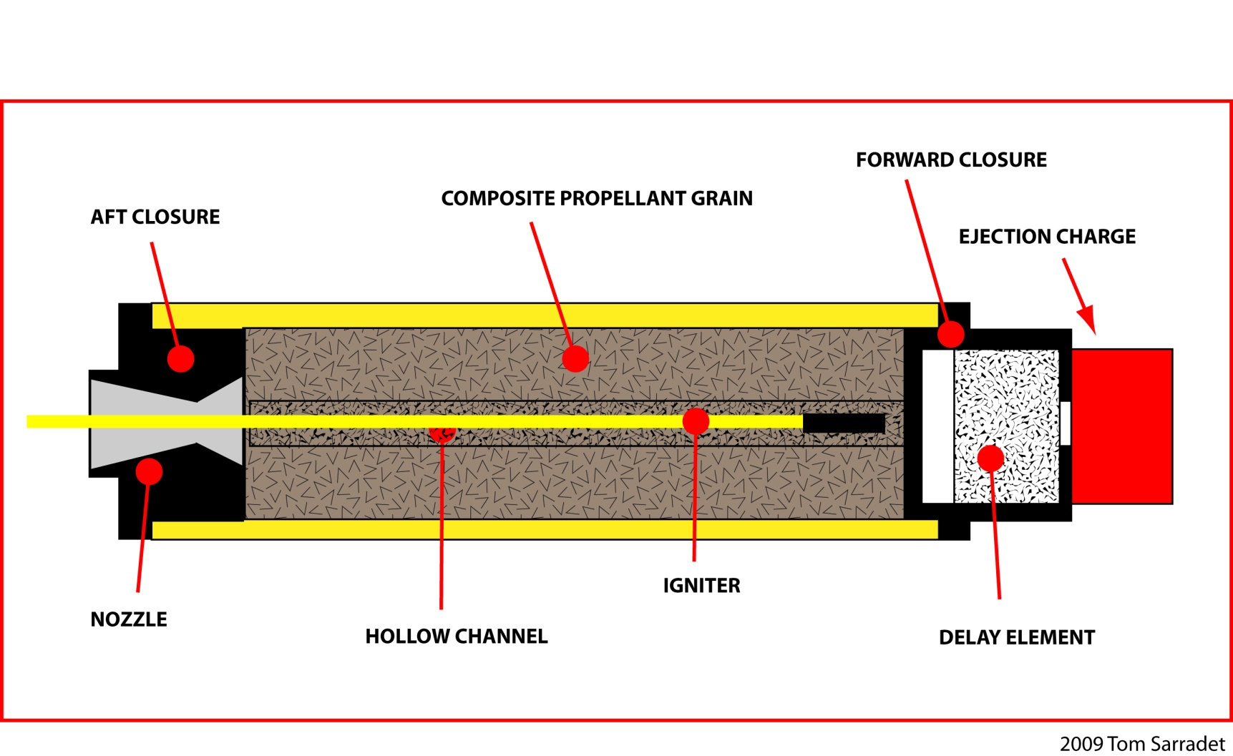
Composite Reloadable Motor
Notes:
The parts of a Composite Reloadable Engine:
The case is a reusable part that holds the propellant. Also reusable are the forward and aft closure.
The nozzle is only used once and directs the thrust rearward.
The composite propellant grain is a spongy material that does not break if dropped. It is the same type of propellant used in the NASA Space Shuttle boosters.
The igniter is pushed all the way forward into the propellant grain.
The delay element is installed inside the forward closure.
The black powder ejection charge is held in place by a plastic cap.

Slide 17
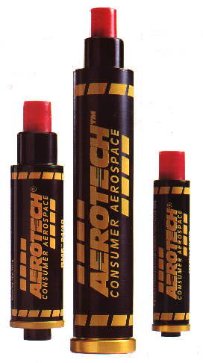
Composite Motor Burn
Composite motors burn from the inner core out.
The delay element is ignited with the propellant and burns forward. Because of this, tracking smoke is produced immediately.
The delay element ignites the ejection charge.
Notes:
Composite Motor Burn
Composite motors burn from the inner core out.
The delay element is ignited with the propellant and burns forward. Because of this, tracking smoke is produced immediately.
The delay element ignites the ejection charge.

Slide 18
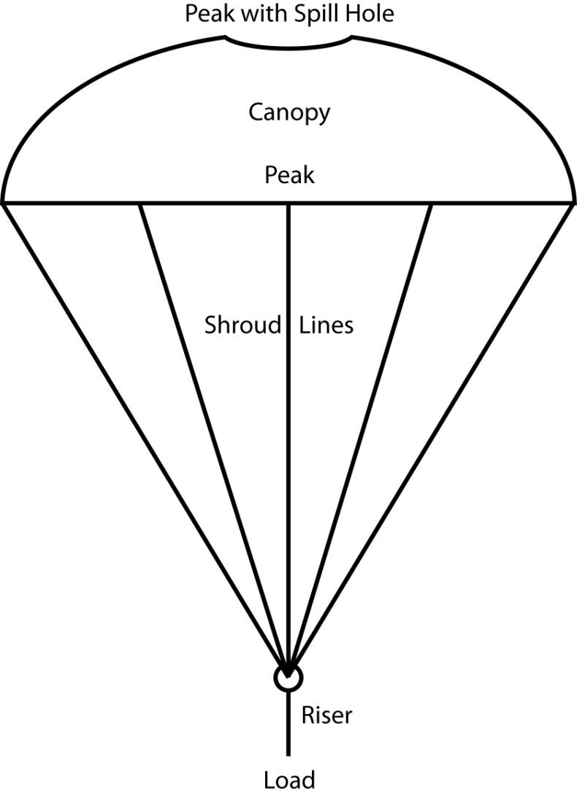
Parachute
Parachutes are made out of plastic, Mylar, or rip-stop nylon.
Shroud lines can be carpet thread or Kevlar chord.
The spill hole reduces oscillation and increased descent rate.
Oscillation is a swaying motion as the parachute spills air from its sides.
Adding a riser lifts the parachute out of the turbulence of the rocket, but increases the risk of parachute failure.
Notes:
Parachute
Parachutes are made out of plastic, Mylar, or rip-stop nylon.
Shroud lines can be carpet thread or Kevlar chord.
The spill hole reduces oscillation and increased descent rate.
Oscillation is a swaying motion as the parachute spills air from its sides.
Adding a riser lifts the parachute out of the turbulence of the rocket, but increases the risk of parachute failure.

Slide 19
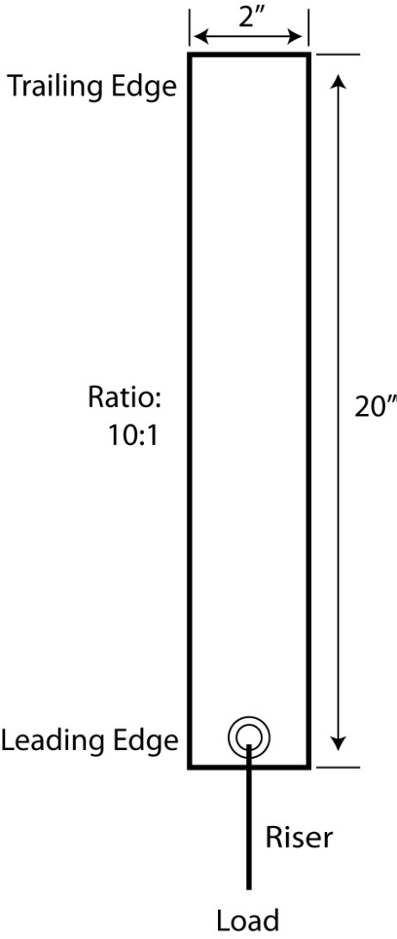
Streamers
Streamers are made out of crepe paper, Mylar, Dura-Lar, or rip-stop nylon.
The best length to width radio is 10:1 to create the most drag as the streamer flaps in the wind.
Streamer recovery is faster than parachute recovery and reduces the recovery area.
Notes:
Streamers
Streamers are made out of crepe paper, Mylar, Dura-Lar, or rip-stop nylon.
The best length to width radio is 10:1 to create the most drag as the streamer flaps in the wind.
Streamer recovery is faster than parachute recovery and reduces the recovery area.

