Slide 1
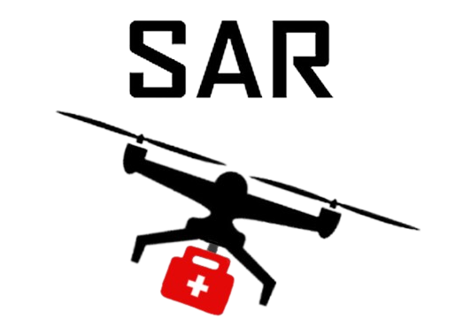
Team SAR Some Assembly Required
Explorer Post 1010
Flight Readiness Review Briefing
Notes:
Nathan
Introduce team (not individuals) - e.g. Team name, Explorer Post 1010, Rockville, participating in UAS4STEM since 2016
2023 Rulebook (Advanced): https://drive.google.com/file/d/1Mi2_LH2hsYAbPQPS31GaID_NoeDhwebQ/view?usp=share_link
4.2.7. The FRR Briefing is a scored element worth 100 Points. The FRR briefing will be assessed on the team’s ability to effectively articulate the scope and depth of the developmental testing performed, the ability of the system design to perform the planned flight tasks, and the preparations made to improve the chances of a successful Flight Mission. [Note from Beth: 25 of those points are for the Mission Planning software assessment - to be confirmed]
4.2.8. The FRR briefing shall not exceed 20 minutes in duration, followed by a maximum period of 5 minutes where the judges will ask questions regarding the presentation and the team shall answer. A judge will time the presentation, may provide a 2-minute warning, and cut off extended presentations as needed.
4.2.9.8. Participation and communication skills will be scored by judges factoring in aspects such as clarity, accuracy, logic, precision, relevance, depth, and suitability. Five judges questions will also be posed prior to the mission-planning software assessment. (5%)

Slide 2
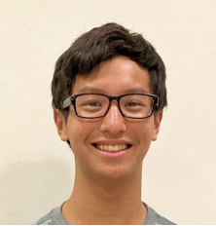
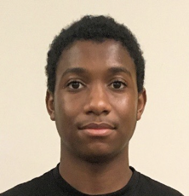
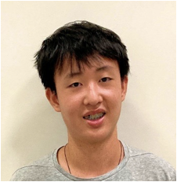
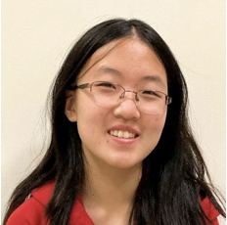
Introductions and Flight Mission Roles
Nathan | Scoring Captain
Muhammed | Safety Pilot/Pilot in Command
Ethan | A.I. Developer/Air Boss
Jasmine | Mission Planner Specialist / Team Captain
Notes:
MUHAMMED: Name, grade/school, role, years on team
NATHAN: Name, grade/school, role, years on team
ETHAN: Name, grade/school, role, years on team
JASMINE: Name, grade/school, role, years on team
2023 Rulebook (Advanced): https://drive.google.com/file/d/1Mi2_LH2hsYAbPQPS31GaID_NoeDhwebQ/view?usp=share_link
4.2.9.1. Team Member Introductions
Including flight mission roles and experience for all team members. (5%)
Speaker notes : we communicate with each other to make sure
We present our own roles, what experience
Everyone participates here
Scoring captain - monitor dude
Other roles:
Video producer
3d printing specialist
Payload specialist (resetting, maintenance, design)

Slide 3
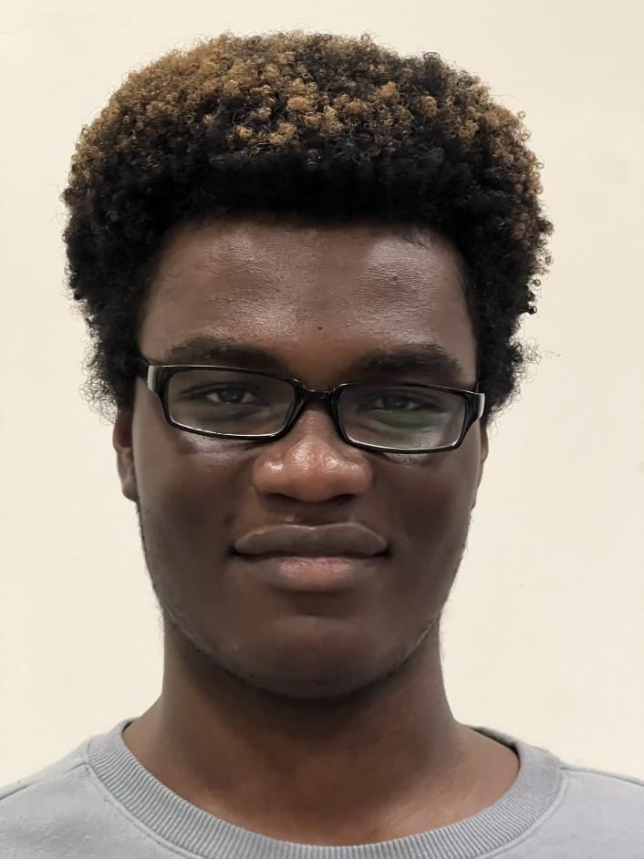
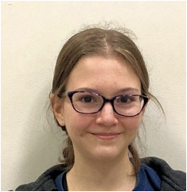
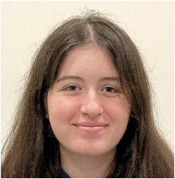
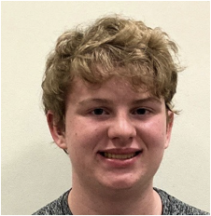
Introductions and Flight Mission Roles (cont’d)
Theo | Safety Specialist
Veronica | Strategic Technician
Lindsay | Visual Observer
Bobby | Aircraft Specialist/ Backup Pilot
Notes:
BOBBY: Name, grade/school, role, years on team
SAM: Name, grade/school, role, years on team
JULIAN: Name, grade/school, role, years on team
VERONICA: Name, grade/school, role, years on team
LINIDSAY: Name, grade/school, role, years on team
2023 Rulebook (Advanced): https://drive.google.com/file/d/1Mi2_LH2hsYAbPQPS31GaID_NoeDhwebQ/view?usp=share_link
4.2.9.1. Team Member Introductions
Including flight mission roles and experience for all team members. (5%)

Slide 4
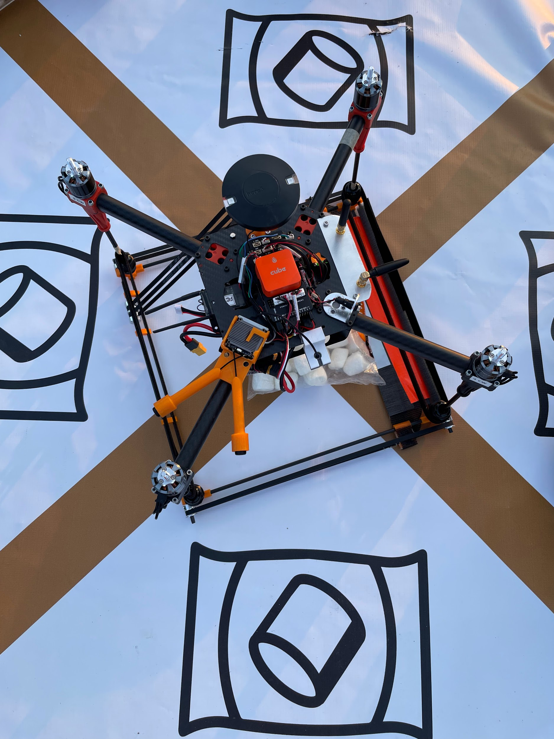
Meet JEFF! (Joint Engineered and Fabricated Flyer)

Slide 5
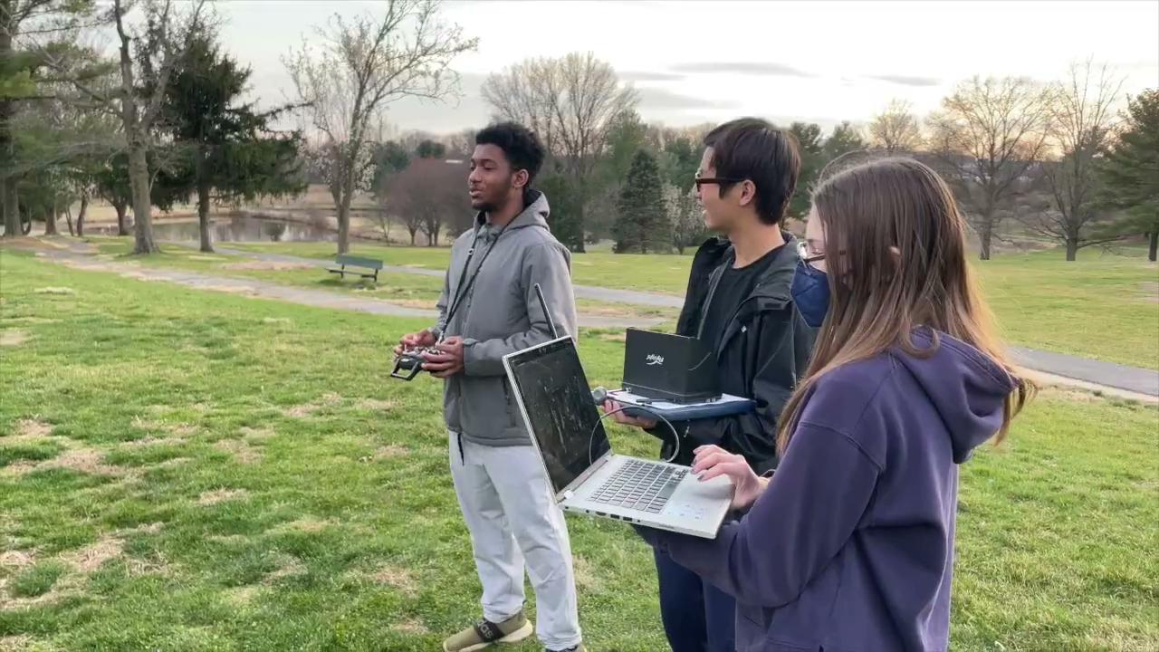
Team Support/Training Video
Notes:
Lindsay
This is our new-team focused support/training video that promotes UAS4STEM.
2023 Rulebook (Advanced): https://drive.google.com/file/d/1Mi2_LH2hsYAbPQPS31GaID_NoeDhwebQ/view?usp=share_link
4.2.9.2: New team support/training video presentation. Teams must present their support/training video to judges. (5%).
2.2.1.5: A one to five minute video that creatively offers support/training to new UAS4STEM teams. Scoring this year is based on a pass/fail parameter.
4.2.2.2: A new-team focused support/training video showcasing UAS4STEM is required. The video shall creatively showcase the UAS4STEM competition and team, offering insight, tips, tricks, or similar support for new teams. A link to the team’s video posted as a private video on the internet (www.youtube.com is preferred) shall be submitted by the specified date and time deadline. The promotional video shall not exceed 5 minutes in length.

Slide 6
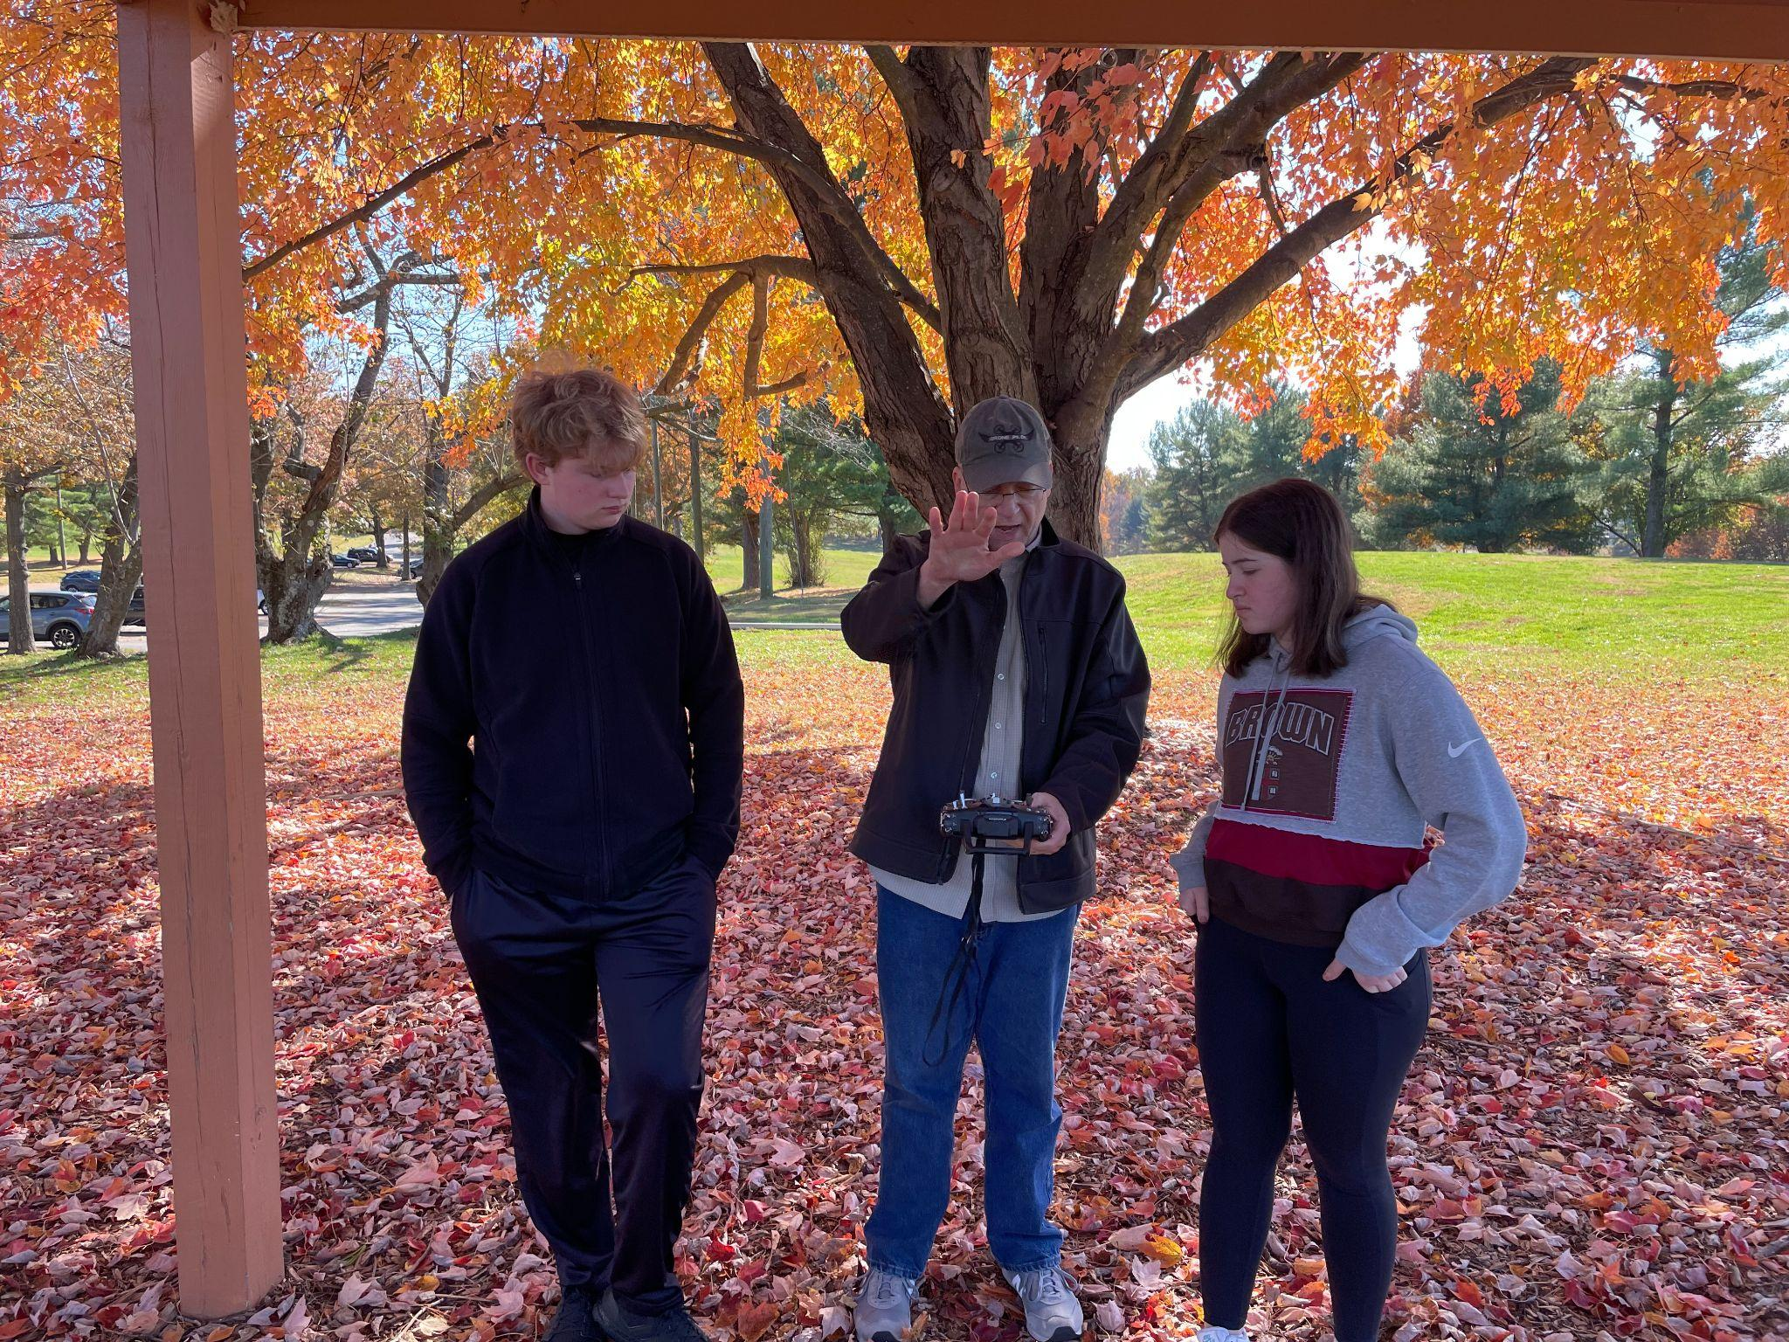
System Overview - Flight Tasks Planned
Accomplish autonomous objectives
Map locations of scoring items while completing autonomous objectives
Hybrid search for further scoring items
Fly to targets
Record coordinates
Fly to pick-up targets (waypoint navigation)
Manually assisted pick-up
Drop-off autonomously (waypoint navigation/auto drop)
Autonomous takeoff and landing
Notes:
Veronica
During the competition, we plan on completing several key objectives to ensure mission success.
First, we plan on accomplishing the autonomous objectives through mission planner. Simultaneously, we will record any scoring items that we see on a map of the flight grounds.
If we’ve missed any targets, we will conduct a hybrid search to quickly find any remaining scoring items.
Once we’ve determined the approximate locations of all scoring items, we will then fly to the targets to record their exact GPS coordinates. Then, we will autonomously navigate to the pick-up targets using waypoints to complete an manually assisted payload retrieval; essentially, the pilot will “nudge” the quad if the location is off. If any step fails, we will switch to a manual flight and correct the location and pick-up.
After this, we will perform an autonomous payload delivery utilizing a pre-programmed mission with the matching coordinates.
Throughout this process, we will complete the autonomous takeoff and landing requirements.
Plan: fly the autonomous objectives and complete required tasks, as we do that we will collect info and map locations of scoring items, then search for any scoring items not found
2023 Rulebook (Advanced): https://drive.google.com/file/d/1Mi2_LH2hsYAbPQPS31GaID_NoeDhwebQ/view?usp=share_link
4.2.9.3. System Overview
Relating to flight tasks planned, expected performance, and any risk evaluation. (15%)
To complete the flight tasks we plan to first fly the autonomous objectives. Then, using the information we gather in that flight, we will autonomously fly to scoring items and complete required tasks which include recording coordinates, moving the payloads, and completing an autonomous landing. To complete further tasks not identified during the first autonomous waypoint mission, we will manually search for additional scoring items. We begin with an autonomous takeoff, and through the course of our flights we accomplish a number of autonomous landings.

Slide 7
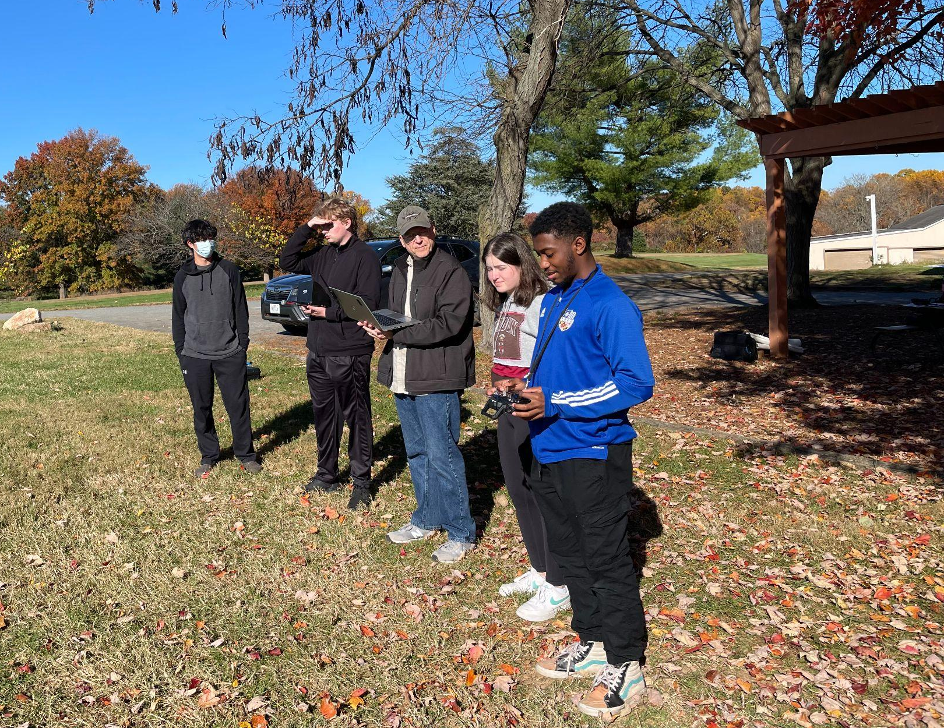
System Overview - Expected Performance
Successfully execute Flight Mission
All 6 target coordinates recorded
3 payloads transferred
Manually assisted autonomous
pick-up and drop-off
Mission completed within <30 minutes flight time
Autonomous takeoff and landing
Notes:
Lindsay
We plan on successfully executing the flight mission and all required tasks.
In under 30 minutes, we expect to complete the flight mission and record the coordinates of all six targets. We also expect to transfer all of the payloads with autonomous drop off and autonomous assisted pick up, and complete an autonomous take off and landing.
2023 Rulebook (Advanced): https://drive.google.com/file/d/1Mi2_LH2hsYAbPQPS31GaID_NoeDhwebQ/view?usp=share_link
4.2.9.3. System Overview
Relating to flight tasks planned, expected performance, and any risk evaluation. (15%)

Slide 8
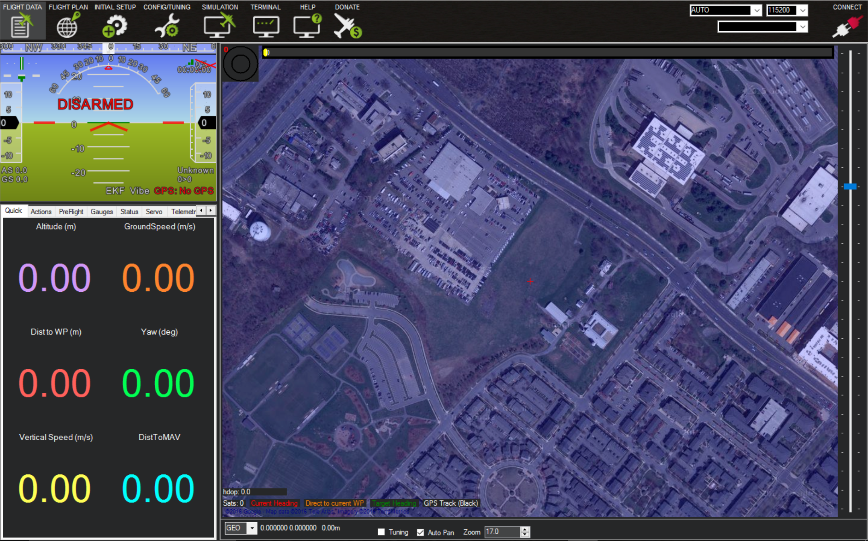
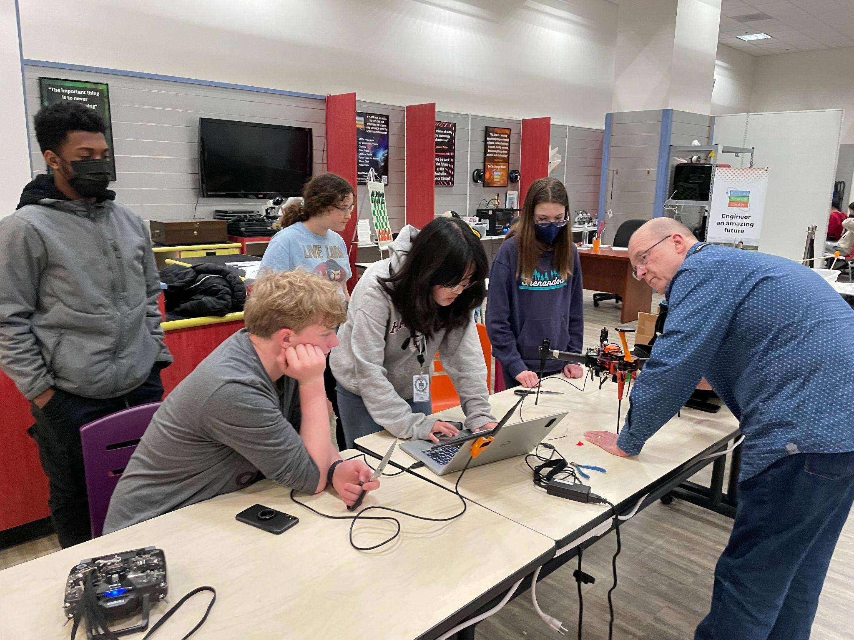
System Overview - Mission Planner Usage
Monitor aircraft telemetry data
Safety dashboard (arm/disarm, GPS status, flight mode)
Program autonomous missions
Control payload mechanism servo
Simulate missions
Notes:
Jasmine
We plan on using mission planner for several tasks throughout the competition.
For one, we monitor aircraft telemetry during all flights to ensure that the quad functions correctly and safely. To do this, we created a safety dashboard widget which ensures that we have constant access to important safety data, such as armed/disarmed status, GPS status, and flight mode.
We also use mission planner to program our autonomous missions necessary for the competition, as well as controlling the payload grabber servo.
To do this, during missions, the scoring captain will relay to the mission planner specialist on when to operate the grabber.
Additionally, we use mission planner to simulate autonomous missions, as well as conduct any live practices or tests to better understand aircraft performance. This way, we can make any adjustments to our strategy if necessary.
2023 Rulebook (Advanced): https://drive.google.com/file/d/1Mi2_LH2hsYAbPQPS31GaID_NoeDhwebQ/view?usp=share_link
4.2.9.3. System Overview
Relating to flight tasks planned, expected performance, and any risk evaluation. (15%)
Mention that you are mentoring Veronica and will be working with her to perform the “mission-planning software assessment” for this virtual preliminary competition. (?)

Slide 9
System Overview - Risk Evaluation
Risk | Risk Type | Mitigation
Autonomous payload procedure | Safety / Scoring | Location adjustment while landing, manually close mechanism
Payload system failure/payloads falls unexpectedly | Safety / Scoring | Attached mechanism to all four legs for additional stability, extensive testing, higher quality mechanical parts, decide action based on mission objectives
Damaged payload upon drop-off | Scoring | Replace older payloads, drop-off from lower altitude
Disabled backup compass | Safety | Low probability of primary compass failing
Flight Beyond Visual Line Of Sight (BVLOS) | Safety | Confirmed with flight directors that a visual observer will monitor the quad and communicate w/ PIC, team visual observer
Notes:
Muhammed
COMPUTER ASSISTED SEARCH
→ unsafe landing location, drop off from air adds additional risk that payload may bounce/move after drop-off
We acknowledge that there are risks involved with mission completion. We have categorized these risks as either safety or scoring risks, and have identified mitigation strategies.
One major risk that could occur during the autonomous payload procedure is the potential for GPS error this could result in unsafe conditions for landing or an inaccurate reading of location. In these situations, we would safely release the payload while airborne, and for both pick-up and drop-off, we will adjust the location autonomously through Mission Planner, both to save time and prevent possible injury.
Additionally, our autonomous grabber servo procedure could possibly damage the mechanism, as anything going wrong would be difficult to recover from and the timing is not as predictable as we’d like. As a result, we plan on closing the mechanism manually to reduce risk of damage.
Payload system failure stuff
Similarly, another possible risk is that the payload could fall unexpectedly during flight. We have identified two ways of handling the risk. One possible option is to immediately pick up the payload if we feel there’s enough time or leave the payload if it had landed in a safe location. The second option is to complete the other mission objectives first, especially if we’re short on time or if the payload is in a dangerous location.
Damaged payload upon drop-off
Disabled backup compass, as servo grabber interferes with compass
We’ve also confirmed with the flight directors that for the competition, a visual observer will be present.
2023 Rulebook (Advanced): https://drive.google.com/file/d/1Mi2_LH2hsYAbPQPS31GaID_NoeDhwebQ/view?usp=share_link
4.2.9.3. System Overview
Relating to flight tasks planned, expected performance, and any risk evaluation. (15%)

Slide 10
System Overview - A.I. Based Autonomy
Vision based DNN/SSD to maintain target lock through delivery
Unfortunately the model’s accuracy was too low (<30%), it didn’t provide enough benefits.
We will implement a Hybrid approach for autonomy next year
MP for coarse navigation to target
Vision based DNN/SSD to maintain target lock through delivery
Automated payload drop for delivery
Draw a bounding box around the target
Calculate if the vertices of the square match the supposed coordinates of the target
Utilize Closed Loop software control to guide the Quad over the target and release the payload
Notes:
Ethan
To accomplish our autonomous payload pick up, we are working on a hybrid approach to leverage the strengths of AI. Firstly, we use Mission Planner to navigate to the target. Then, we trained a Deep Neural Network to draw a bounding box around the target. There would then be an automated payload drop off for the delivery. To ensure accuracy, the Bounding Box component draws a square around the target and calculates if the vertices of the square match the supposed coordinates of the target. This step helps to minimize errors and ensure that the payload is dropped at the correct location. Finally, the Closed Loop Control software guides the Quad over the target and releases the payload. This software uses feedback from sensors on the drone and the AI to adjust its position and ensure that the payload is released accurately.
2023 Rulebook (Advanced): https://drive.google.com/file/d/1Mi2_LH2hsYAbPQPS31GaID_NoeDhwebQ/view?usp=share_link

Slide 11
System Overview - Risk Evaluation – A.I.
False Positives
Misidentify targets
Can result in harm or damage
False negatives
Miss real targets, miss points in the competition
Reliability
May not be reliable in complex environments
Malfunctions result in false negatives/positives
Notes:
Ethan
As we plan on using A.I. this year to assist in payload retrieval, there are several risks that must be considered. One of the most significant challenges is the issue of false positives. False positives occur when the system misidentifies a target, leading to harm or damage. False negatives are another challenge. This occurs when the system misses real targets or misses points in a competition. This can lead to missed opportunities or even failure to achieve the desired outcome. Reliability is also a significant challenge. AI-based target recognition may not be reliable in complex environments, such as in varying lighting conditions. Malfunctions in the system can result in false negatives or false positives, which can have severe consequences.

Slide 12
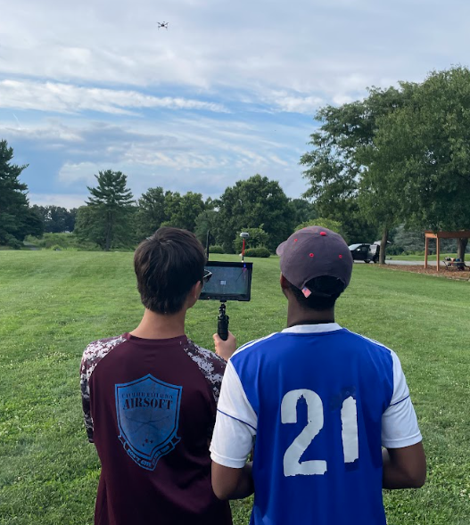
System Overview - Monitor Usage
New digital camera + receiver
Payload capture assistance
Flight decisions made based on:
Camera and receiver battery voltages
Temperature
Signal quality
Distance
Quad location
Notes:
Nathan
The monitor lets us see what the drone sees, which helps with locating and identifying payloads and avoiding obstacles. It allows the pilot to land accurately, as well as confirm that the quad is in a position able to capture the payload and that the RTMT is functioning properly (?). We also have a separate set of data related to the camera, which includes information such as camera and receiver battery voltages and camera temperature, so that if it starts overheating we can intervene.
The monitor is what we use to see what the drone sees, which allows us to find scoring items or payloads. It also gives us a second set of data separate from Mission Planner to ensure we know critical information such as lat/long, altitude, or battery voltage.
2023 Rulebook (Advanced): https://drive.google.com/file/d/1Mi2_LH2hsYAbPQPS31GaID_NoeDhwebQ/view?usp=share_link
4.2.9.3. System Overview
Relating to flight tasks planned, expected performance, and any risk evaluation. (15%)

Slide 13
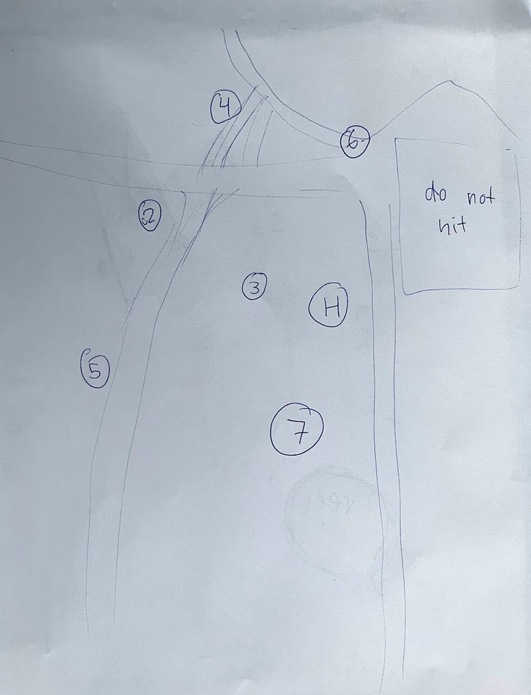
System Overview - Maps
Consolidation of Data:
Target location relative to surface features
Type of Target
Latitude/Longitude
Possible Obstacles
Review after flight
Notes:
Veronica
As we fly the autonomous mission, we will record on the map the target location relative to other landmarks, labels indicating the type of target, as well as adding the latitude and longitude as we proceed through the mission. We will also record possible obstacles through what we see from the camera.
2023 Rulebook (Advanced): https://drive.google.com/file/d/1Mi2_LH2hsYAbPQPS31GaID_NoeDhwebQ/view?usp=share_link
4.2.9.3. System Overview
Relating to flight tasks planned, expected performance, and any risk evaluation. (15%)

Slide 14
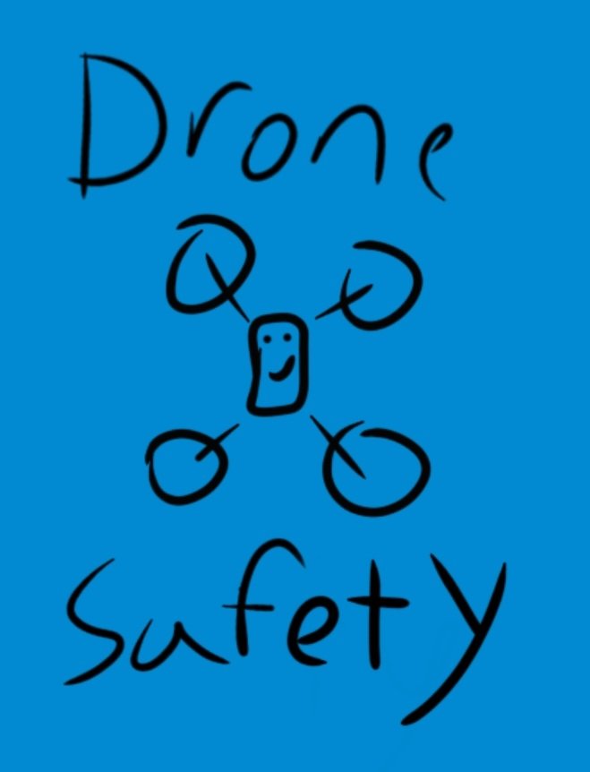
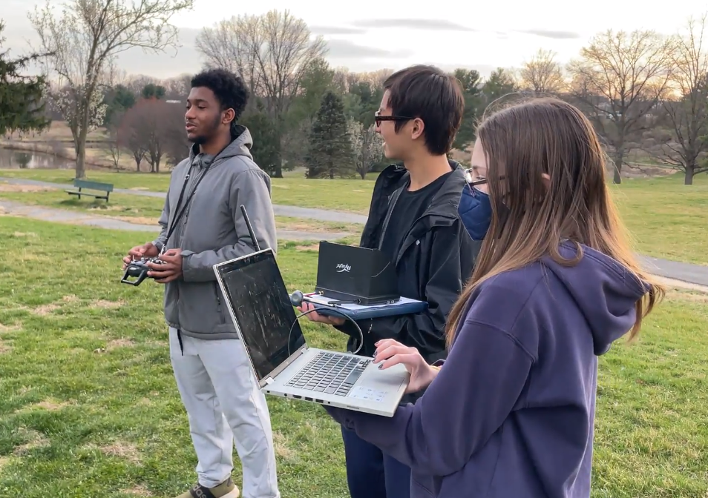
System Safety - Operational Strategies
ALL flights conducted:
With supervising adult
In visual line of sight with visual observer
BELOW 400 feet and within FAA regulations
NO flights conducted:
Without performing pre-flight inspection
In bad weather or bad visibility
Over people or buildings
Notes:
Theo
When flying a quad, safety is our number one priority. To ensure a safe flight every time, we always make sure to do everything listed on the slid, as well as always establishing a flight line to stay behind before the flight, reminding everyone that they should have their eyes on the quad whenever it’s in the air, as well as having first aid equipment and fire extinguishers on hand in case of an emergency.
We never conduct flights without performing a pre-flight inspection to the quad to ensure that all systems are working properly, and that no hardware or software has been damaged or has any issues. We also will never fly in bad weather or with bad visibility, and never over people or buildings.
2023 Rulebook (Advanced): https://drive.google.com/file/d/1Mi2_LH2hsYAbPQPS31GaID_NoeDhwebQ/view?usp=share_link
4.2.9.4. System Safety
With identified design and operational strategies. (10%)

Slide 15
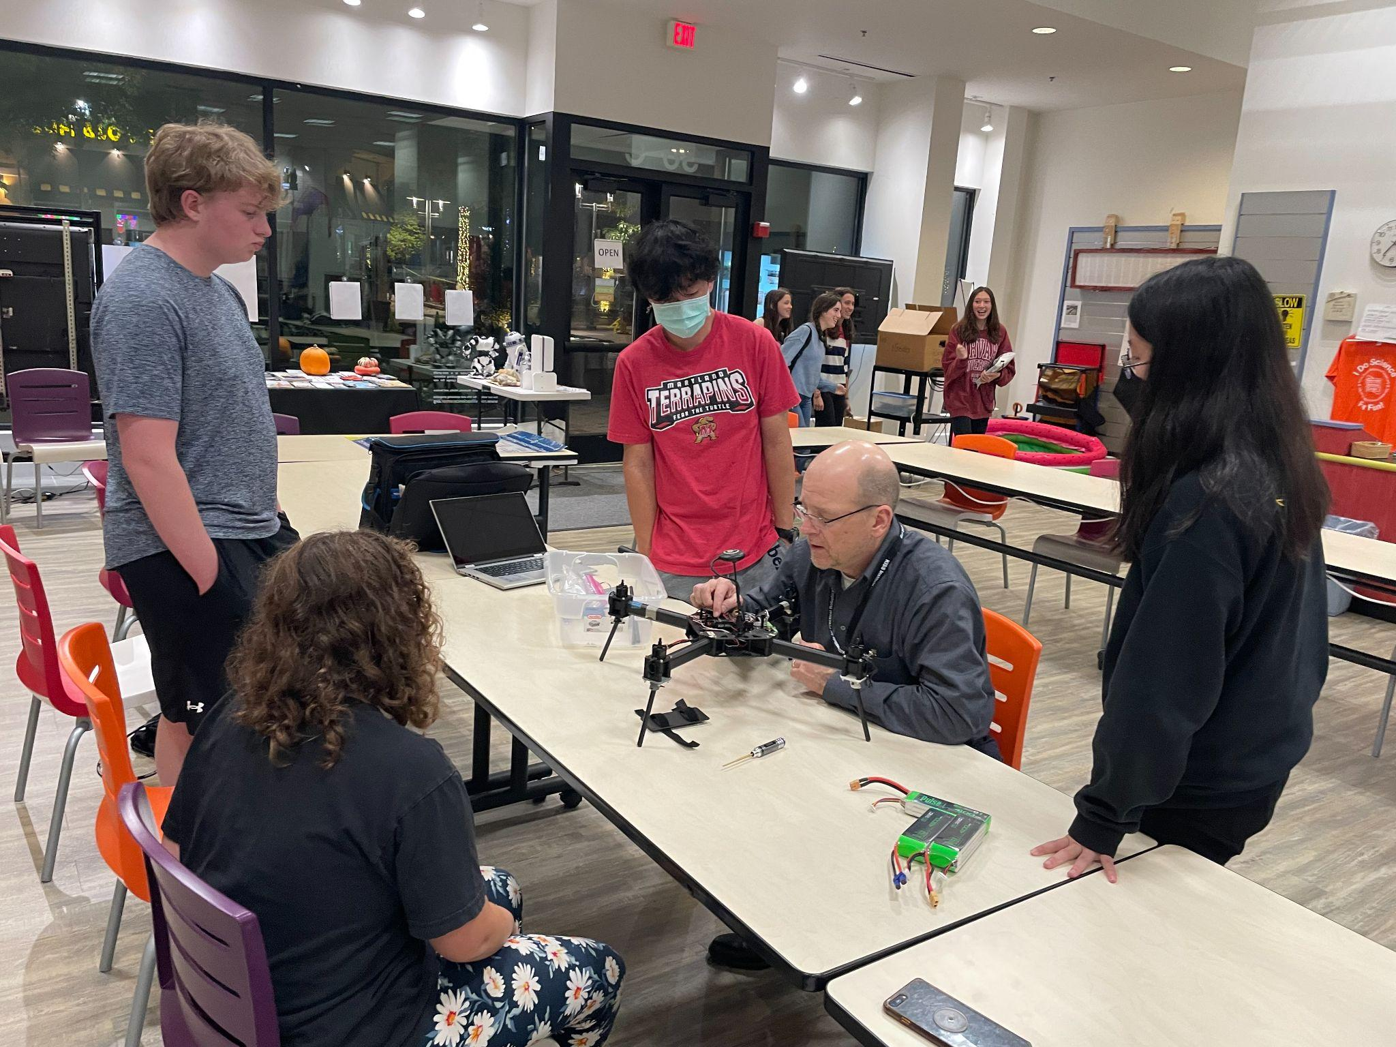
System Safety - Design and Operational Strategies
High quality components (sufficient infill, appropriate layer height, high quality carbon fiber connecting components)
Verified failsafe RTL action
We use checklists to enforce safety
Maintain safe altitude when crossing over obstacles
Repairs made w/ consent from all members
Notes:
Bobby
For our design strategies, we used the highest quality components we could to ensure safety and efficacy. We did this by using sufficient infill and appropriate layer height for 3d printed parts and carbon fiber components for our payload grabber.
In designing and operating our quad, we always keep safety in mind. We make sure that our RTL, or return to launch, is active, in any emergency.
For operational strategies both before flying and after flying, we always use checklists to enforce safety; we don’t want to forget anything important, such as verifying failsafes, checking the strength of video signal, or setting both minimum and maximum altitudes.
Part of this is inspecting the quad before flight, because any broken or damaged parts would be a major risk to our safety, others’ property, as well as the condition of our quad.
We also always make sure to maintain a safe altitude when crossing over obstacles, as otherwise damage could easily be done to property.
Repairs are made with the consent of all team members, so everyone knows what is happening and where it’s happening.
Checklists:
Inspect aircraft parts before each flight
2023 Rulebook (Advanced): https://drive.google.com/file/d/1Mi2_LH2hsYAbPQPS31GaID_NoeDhwebQ/view?usp=share_link
4.2.9.4. System Safety
With identified design and operational strategies. (10%)

Slide 16
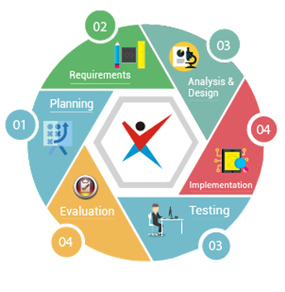
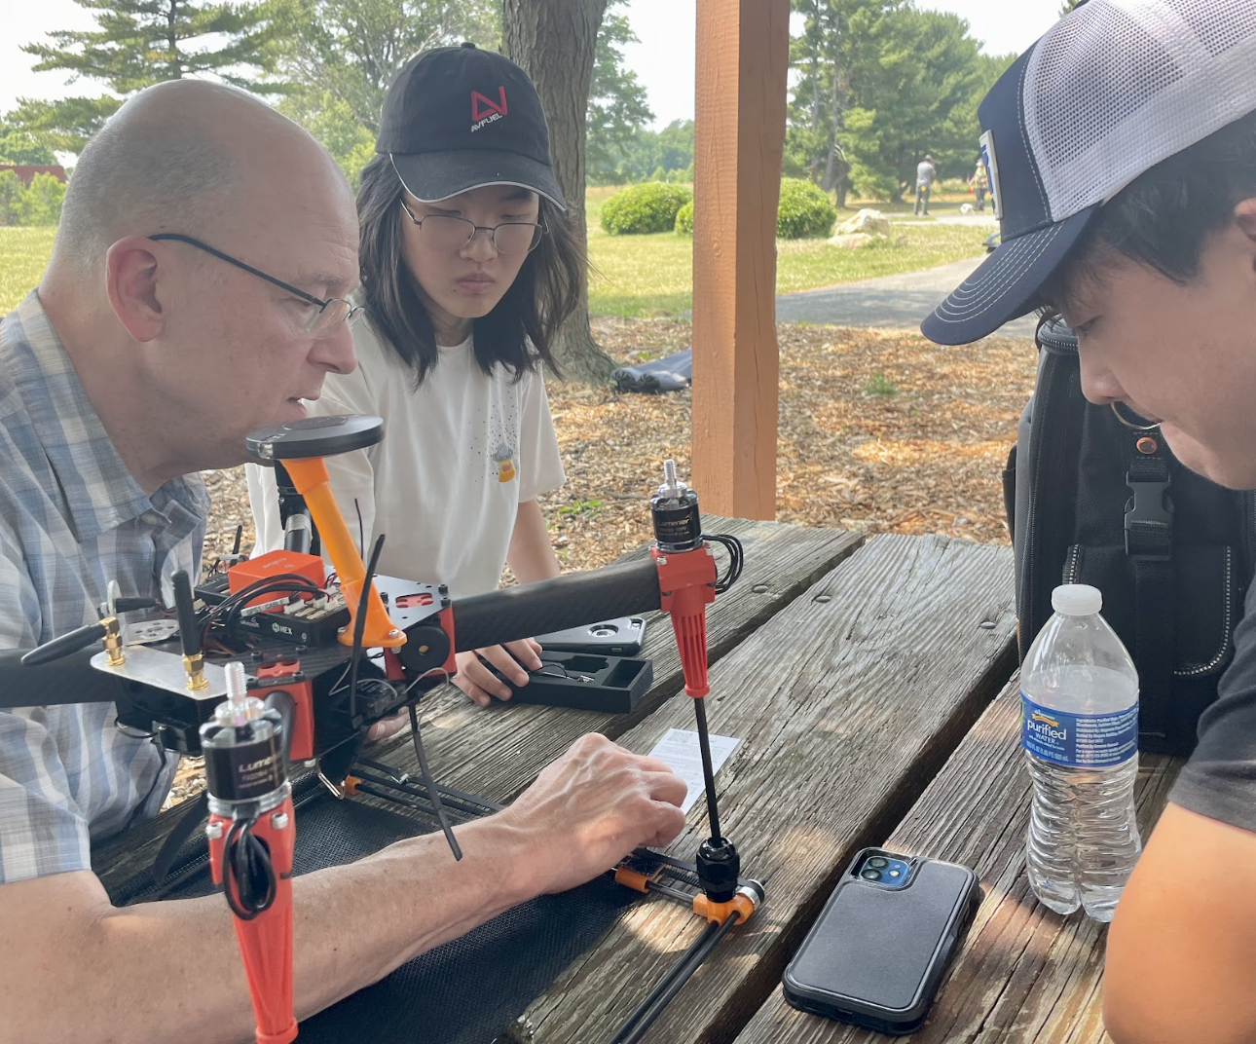
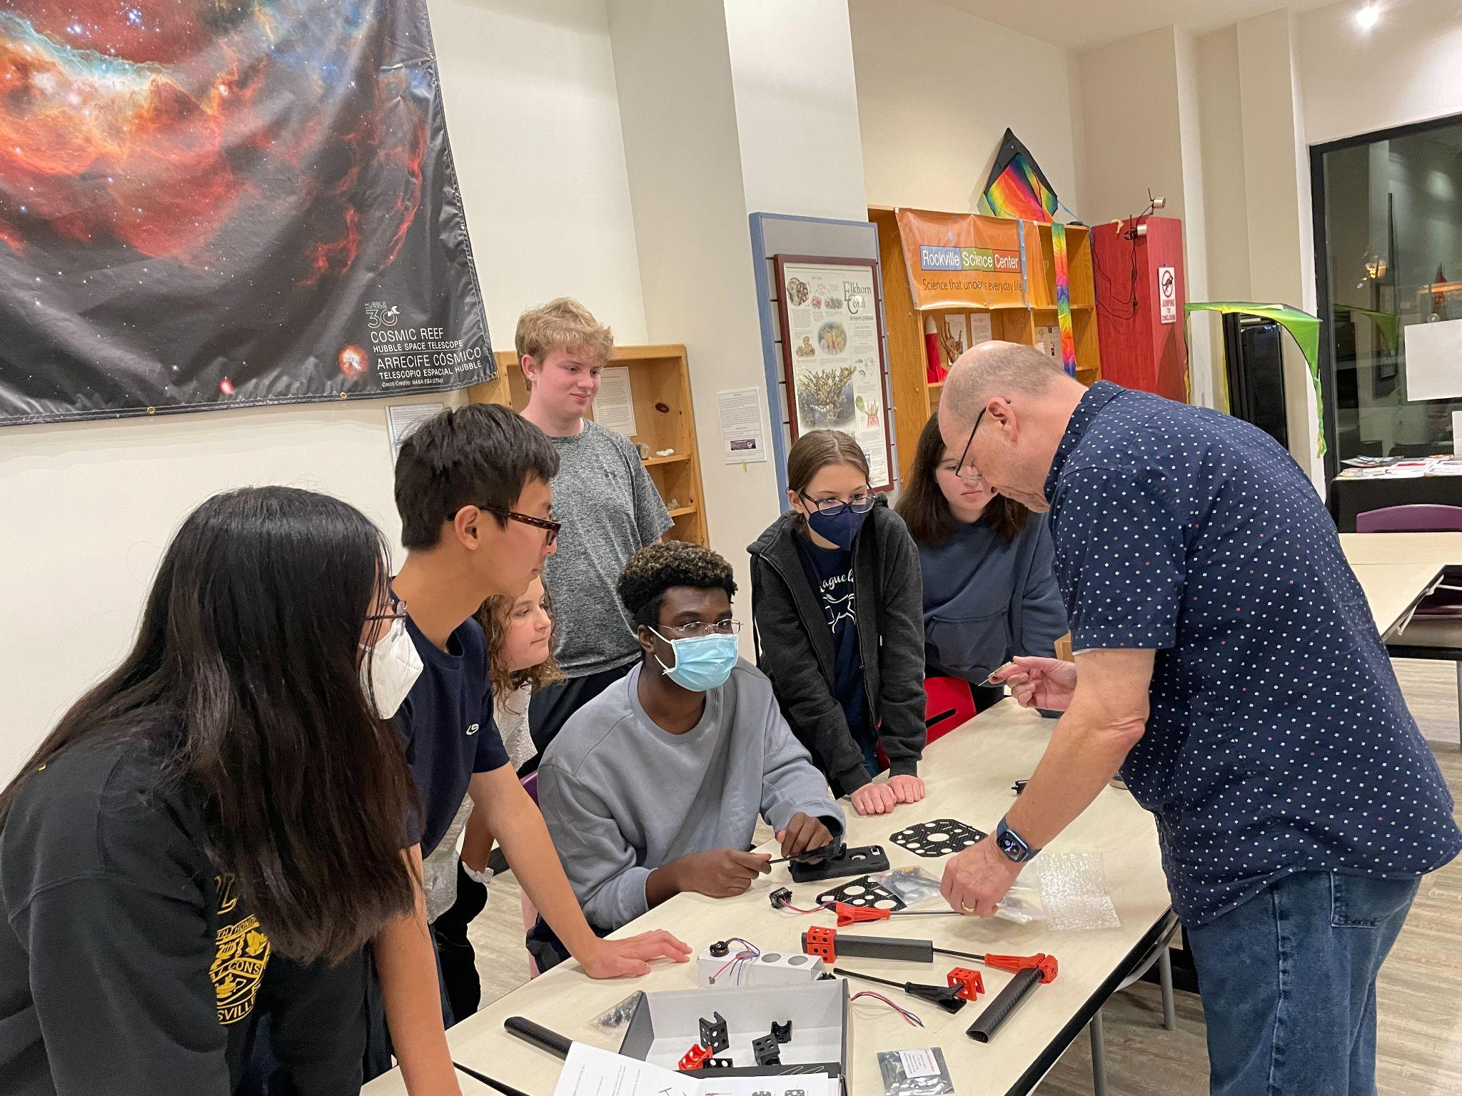
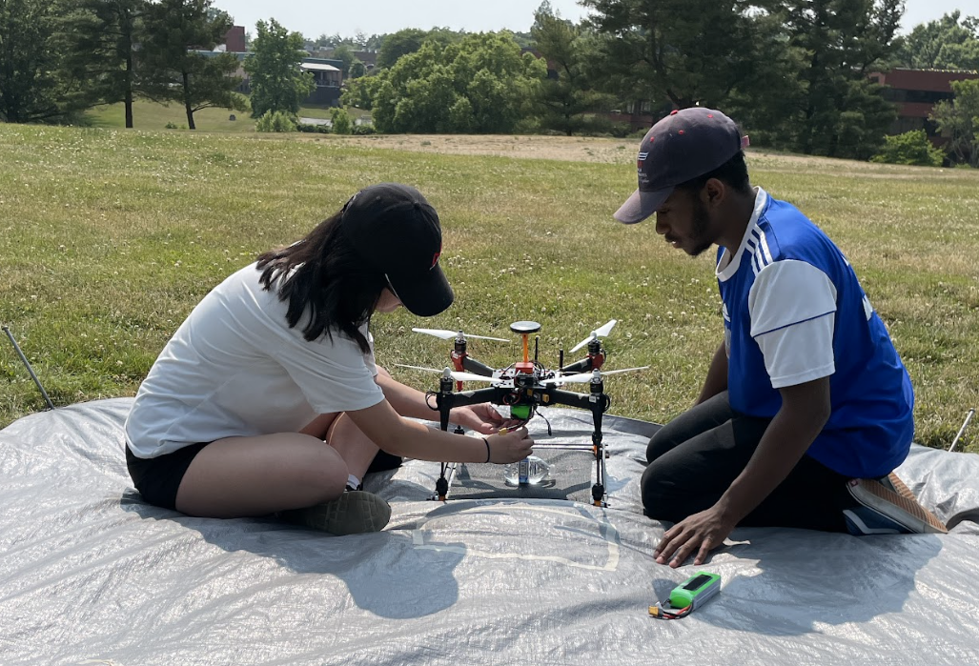
Developmental Test - Test Planning
Prototype Completion
Independent System Test (off quad)
Integrated Ground Test (on quad)
Basic Flight Test (airworthiness)
Aerial System Test in open field
Mission Performance Test
Notes:
Jasmine
Before we implement any changes to the system, we follow a six-step process through incremental testing to always focus on safety and functionality. This year, we built a new quad from a kit that we ordered as well as a new payload grabber to adjust to the new rules and objectives.
We first completed a prototype of our grabber mechanism and an independent system off the quad to ensure that the key concepts are addressed and so that new systems will function as intended. For example, with our payload mechanism, we wanted to ensure that it was both lightweight and had a large margin for error, so those were ideas we kept in mind when prototyping.
With independent tests, we ensured that our actual mechanism worked as intended with no major issues.
We then completed an integrated ground test to ensure that there is no interference with other systems on the quad, such as antennae or cameras. In particular, servos can easily interfere with other systems on the quad, so we wanted to make sure that everything was functioning as intended.
After this, we completed a basic flight test with our grabber mechanism. There was a concern that the grabber could interfere with the quad’s ability to fly, but luckily, we haven’t found any issues. With this, we then proceeded with a full test of the system in an open field and then simulated the official mission to ensure that overall, everything functions smoothly.
We followed a similar process with our new quad, where after building completion we tested it on the ground w/ no props to ensure that none of the system was encountering any issues before then flying it. This way, any problems can be addressed without it becoming a major risk to safety. What we found in our ground testing was that the motors and ESCS on the quad were faulty and needed replacement.
Servo interfered with internal compass, switched to just using external
Flew stably, did not draw too much current while in flight
2023 Rulebook (Advanced): https://drive.google.com/file/d/1Mi2_LH2hsYAbPQPS31GaID_NoeDhwebQ/view?usp=share_link
4.2.9.5. Developmental Test Results
Including: test plan schedule (through ground testing to flight testing to mission performance testing), results of testing, and any corrective action taken to improve the effectiveness on mission completion. (15%)

Slide 17
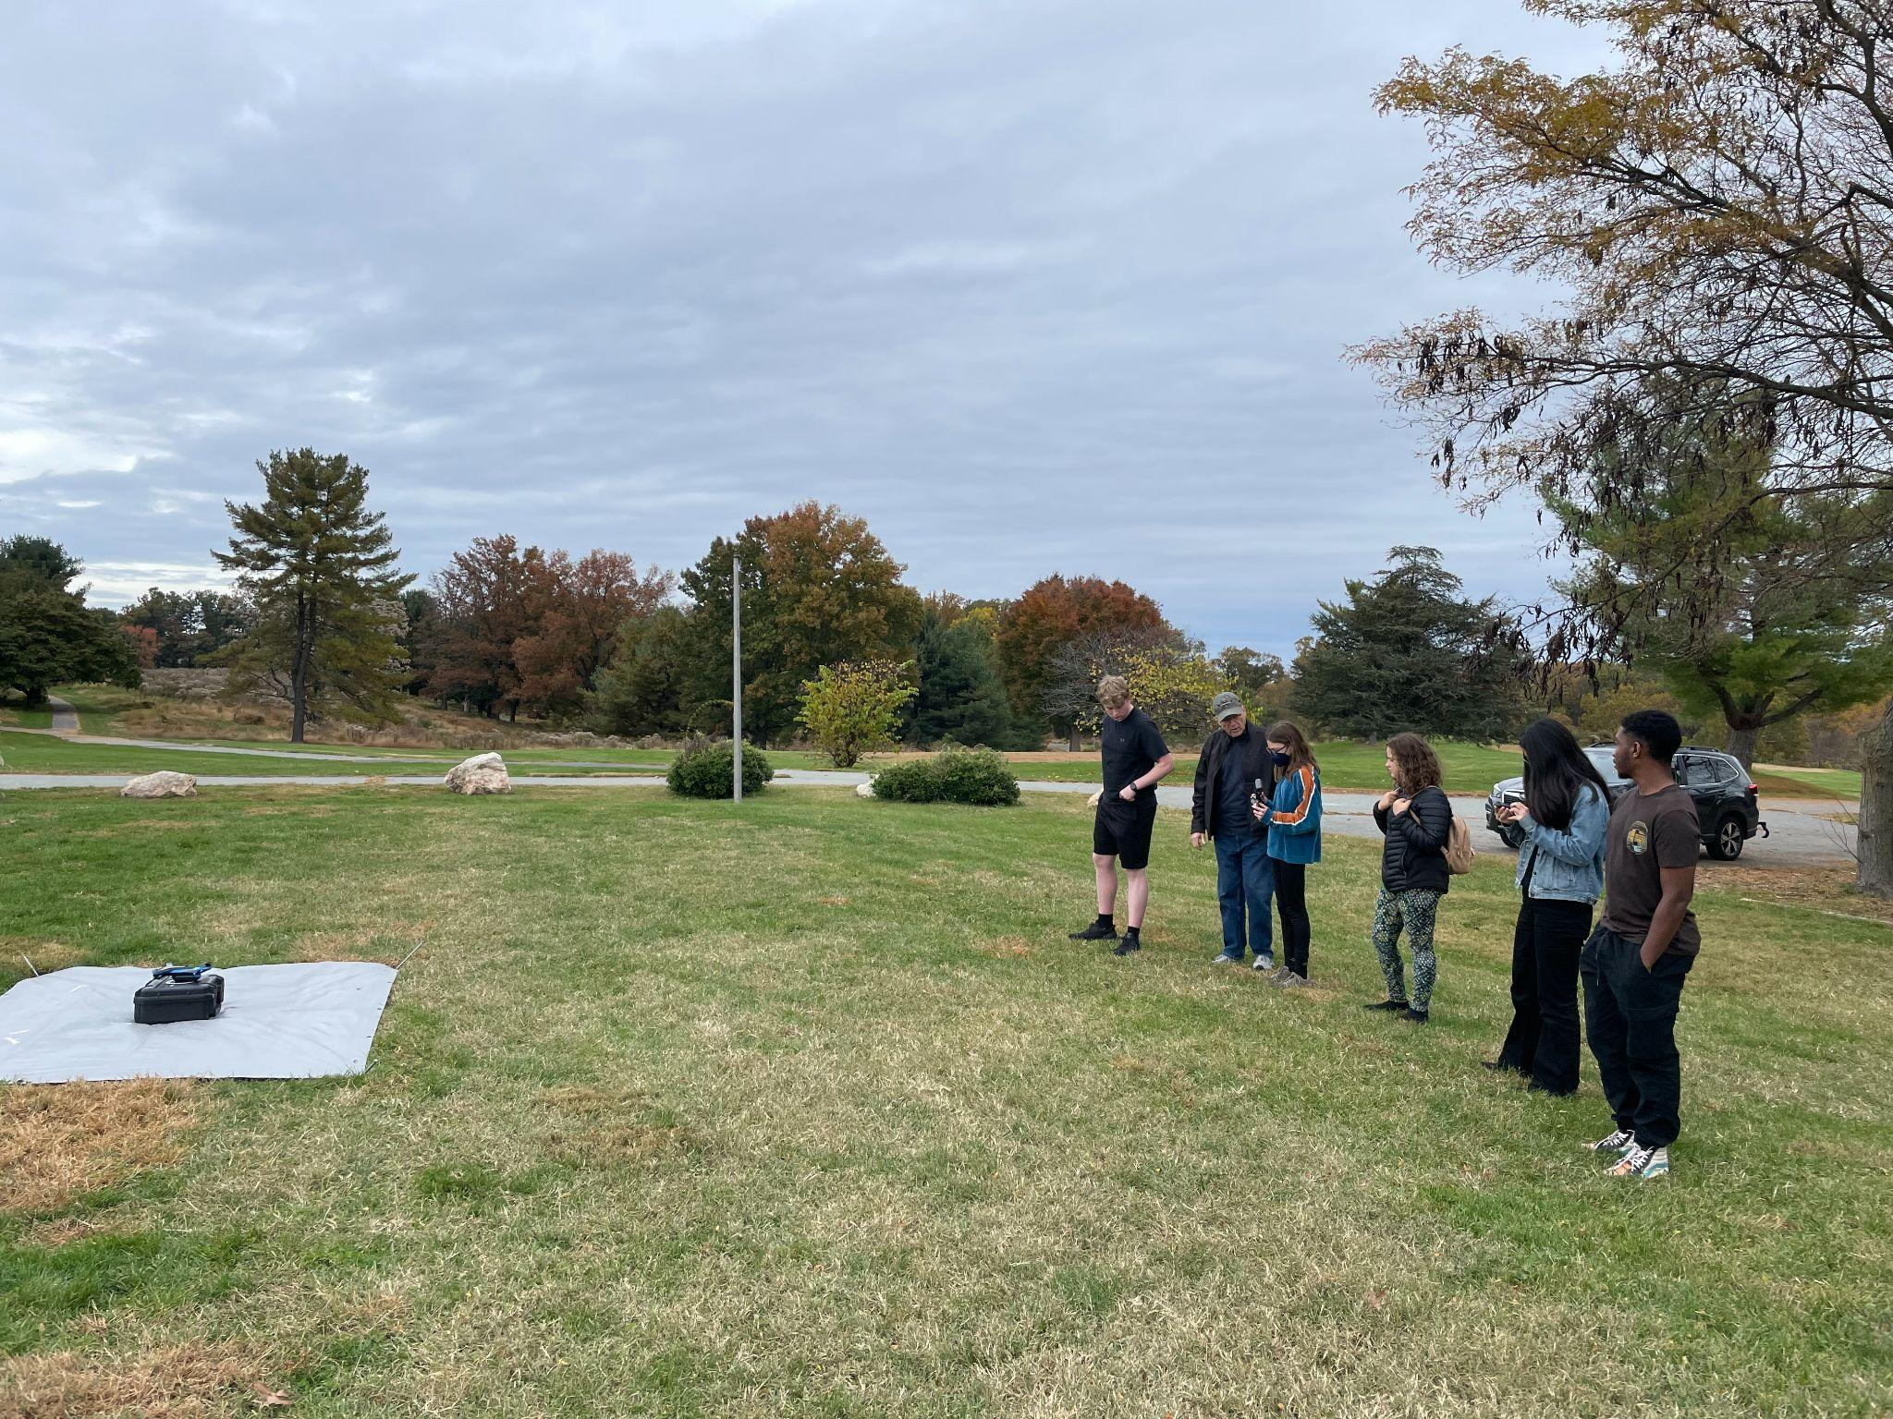
Developmental Test - Ground and Mission Performance
Successfully ground tested and flight tested quad with grabber
Completed autonomous objectives
Transferred payloads
Simulated competition flight experience:
Found scoring items (autonomous map method followed by manual search)
Notes:
Nathan
We performed both ground and flight tests with the quad and grabber, where we were able to successfully complete all autonomous objectives and transfer all 3 payloads consistently.
The Mission Performance Test simulates the competition flight experience at Redgate Park, a former golf course. The test includes finding scoring items with our hybrid search, retrieving and delivering payloads, and completing the autonomous objectives. We also make sure to place our targets in non-visible(?) locations to simulate the conditions for the actual competition. This way, we can fine-tune our performance both as individuals and as a team.
2023 Rulebook (Advanced): https://drive.google.com/file/d/1Mi2_LH2hsYAbPQPS31GaID_NoeDhwebQ/view?usp=share_link
4.2.9.5. Developmental Test Results
Including: test plan schedule (through ground testing to flight testing to mission performance testing), results of testing, and any corrective action taken to improve the effectiveness on mission completion. (15%)
Since we haven't completed development yet, we don't have developmental test results for the whole system yet but we plan on simulating the competition flight experience, testing our operating procedures and communications to ensure efficiency throughout our process.
We plan on testing
Search for scoring items through previous strategies mentioned, with an autonomous map method followed by a manual search
Transferring payloads between targets
Completing autonomous objectives necessary

Slide 18
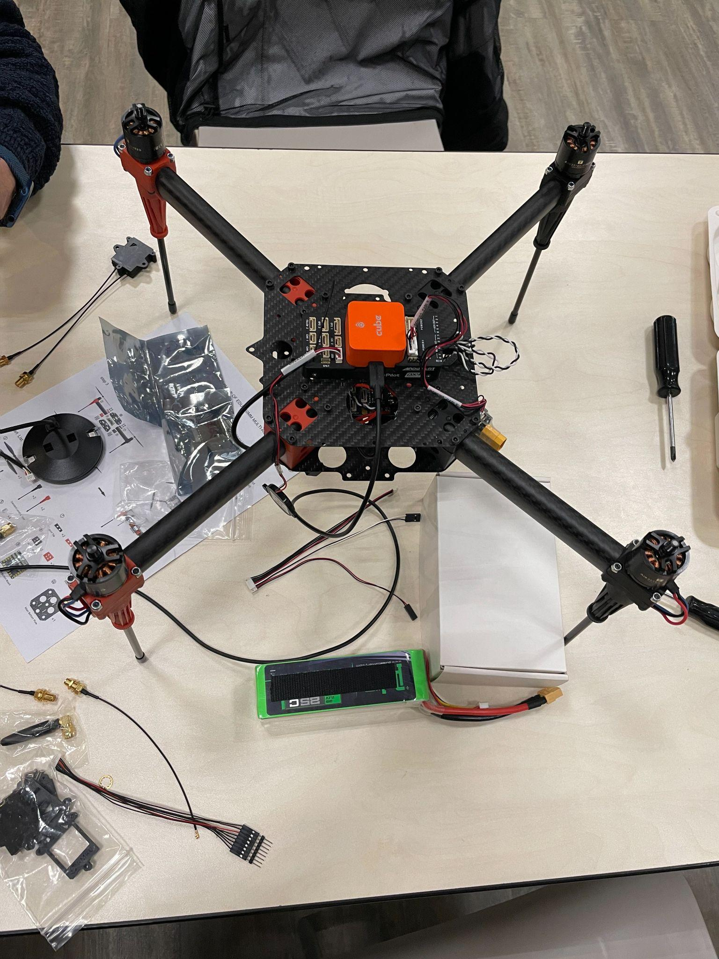
Developmental Test - Corrective Actions Taken
Replaced faulty motors and ESCs, tested new propellers for motors
Antenna mounting
Diversity system
Optimized antenna placement to reduce interference
New digital camera
Custom transmitter mount
Optimized location
Notes:
Bobby
While we were testing, we identified defects with the motors and ESCs that came with the kit that posed a risk to safety and mission success. To address this, we replaced the motors and ESCs with higher quality ones with more reliability.
We also selected propellers that worked the best for our motors
Additionally, we optimized the mounting of the telemetry antennae to take advantage of the new diversity system for a stronger and more reliable signal. We also carefully chose the location of each antenna to minimize interference between the various RF communication systems.
Furthermore, we upgraded our camera to a new digital camera with higher resolution. We created a custom transmitter mount that gives good antenna placement while reducing risk of damage. Additionally, the camera location is as centered as possible. In order to do this, we had to reconfigure our battery position to make room for our mechanisms.
2023 Rulebook (Advanced): https://drive.google.com/file/d/1Mi2_LH2hsYAbPQPS31GaID_NoeDhwebQ/view?usp=share_link
4.2.9.5. Developmental Test Results
Including: test plan schedule (through ground testing to flight testing to mission performance testing), results of testing, and any corrective action taken to improve the effectiveness on mission completion. (15%)

Slide 19
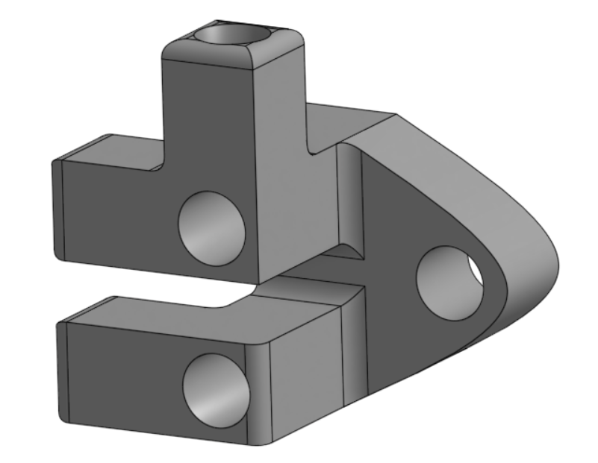
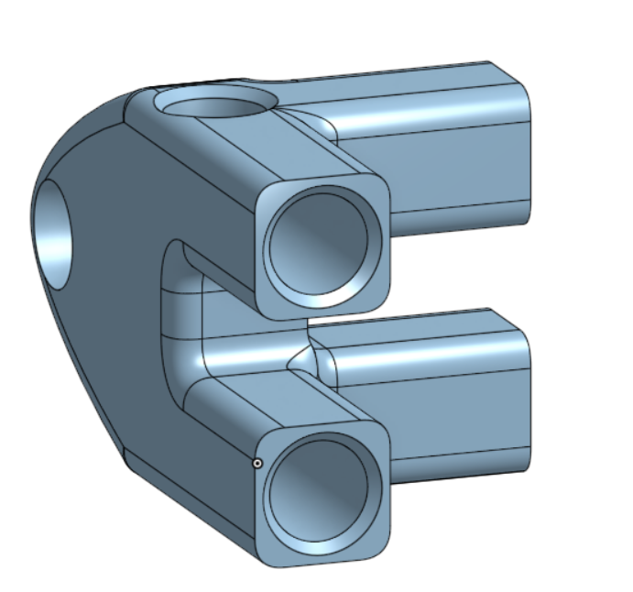
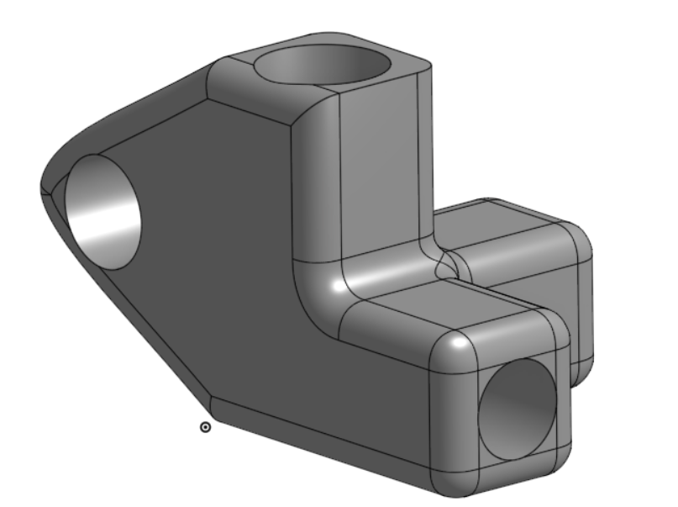
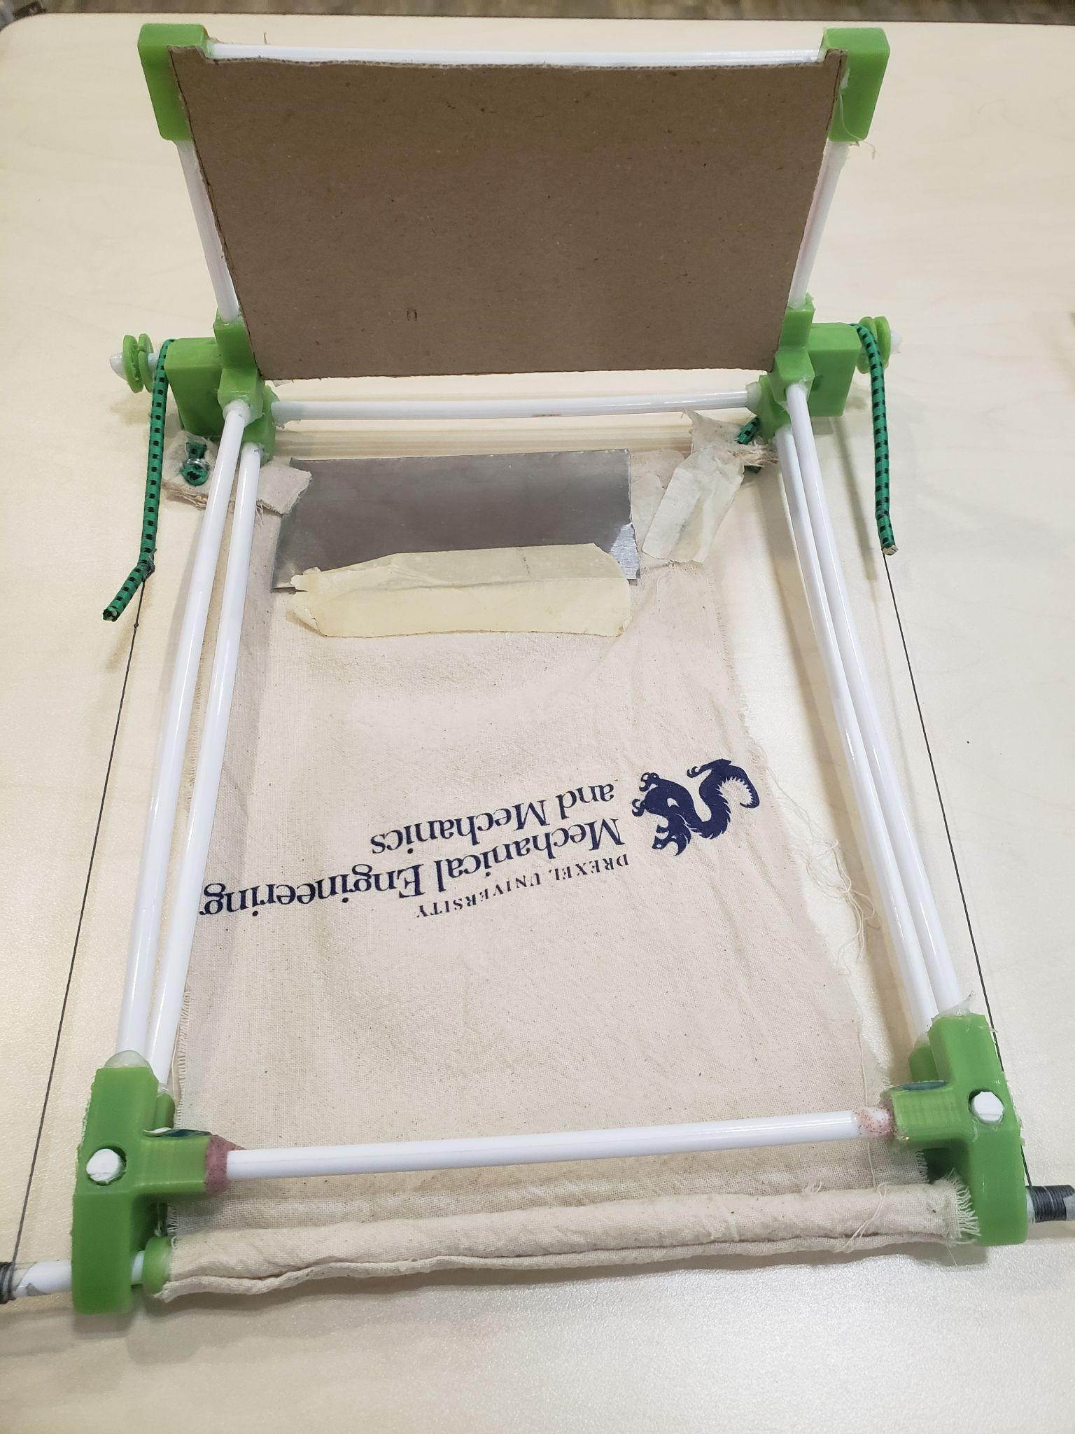
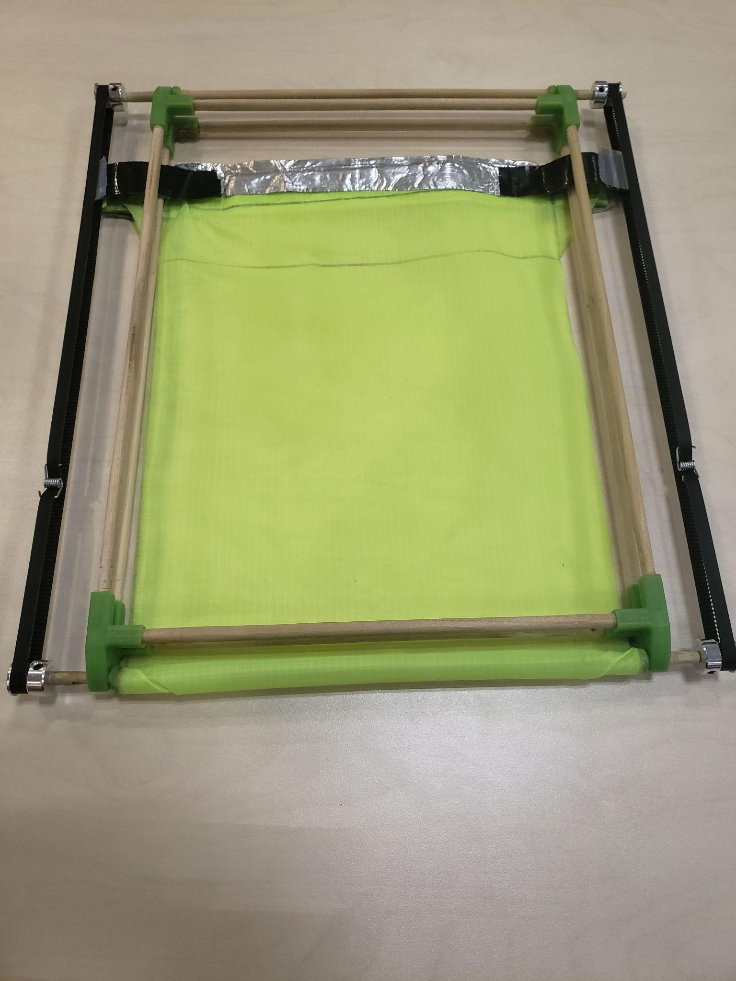
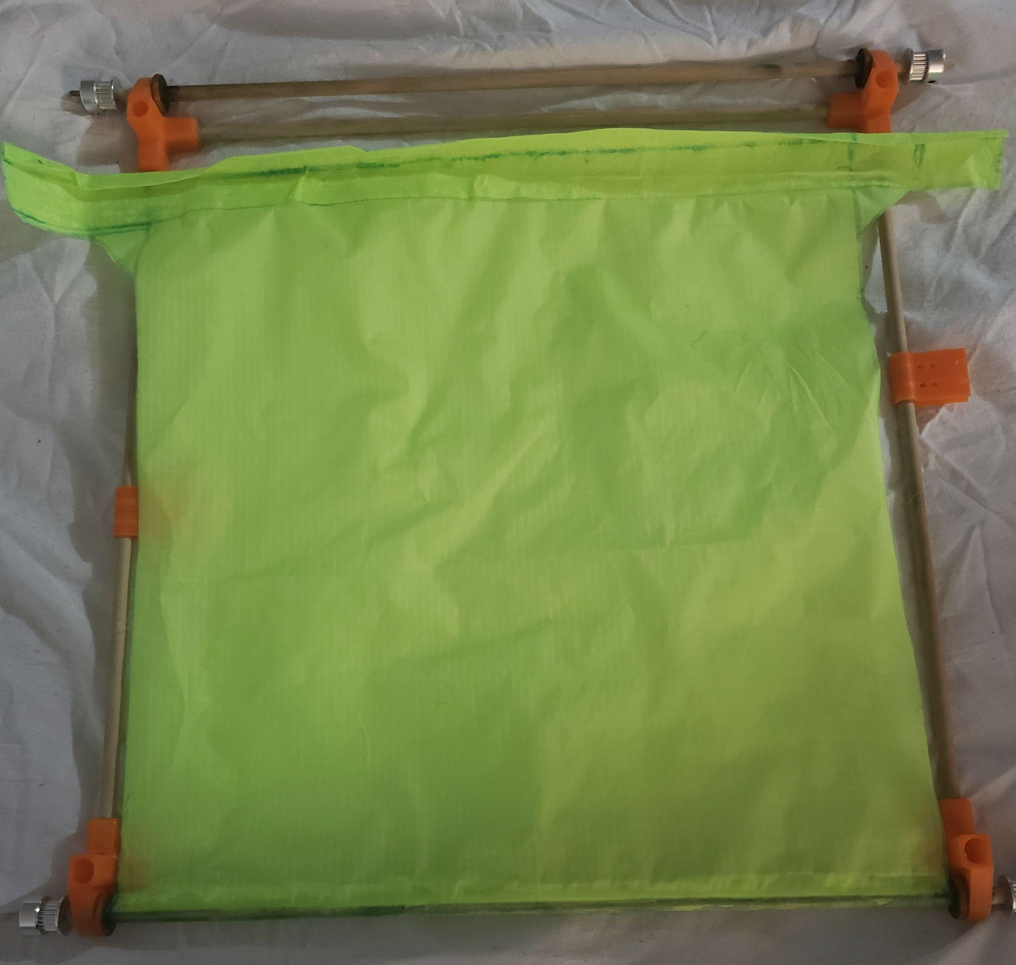
Developmental Test - Corrective Actions Taken (cont’d)
Designed new “grabber”: reverse tablecloth magic trick (RTMT)
Belt driven system for smooth catching of payloads
Focus on reducing weight while maximizing margin of error for landing
Iterated design (Concept → CAD Model → Low cost prototype → Final prototype
Notes:
Muhammed
When developing the grabber mechanism for the drone we came up with many ways to pick up payloads items.And to narrow the ideas down we worked together as a team to gain a better understanding of the problem, and once we did, we were confident enough to focus on an a idea based on magic trick. What exactly is our magic trick you may ask, well it’s the Inverted Tablecloth Pulling Mechanism. It works by the drone landing on the payload with the sheet rolled up then using Belt driven system we roll out sheet from under the payload and the drone flies way. When building the mechanism we first focus on it’s functionality making sure there were no parts that were impeding each other. We then focused on weight reduction using less rods as we progressed in the design. Using cardboard, plastic hangers, wooden rods, and custom 3D printed parts we were also able to keep the of cost on our prototypes low.
2023 Rulebook (Advanced): https://drive.google.com/file/d/1Mi2_LH2hsYAbPQPS31GaID_NoeDhwebQ/view?usp=share_link
4.2.9.5. Developmental Test Results
Including: test plan schedule (through ground testing to flight testing to mission performance testing), results of testing, and any corrective action taken to improve the effectiveness on mission completion. (15%)
2023 notes
Sliding (ITPM) design
Initial cloth + cardboard prototype
Iterated on with changes to materials, size, etc.
2023 Rulebook (Advanced): https://drive.google.com/file/d/1Mi2_LH2hsYAbPQPS31GaID_NoeDhwebQ/view?usp=share_link

Slide 20
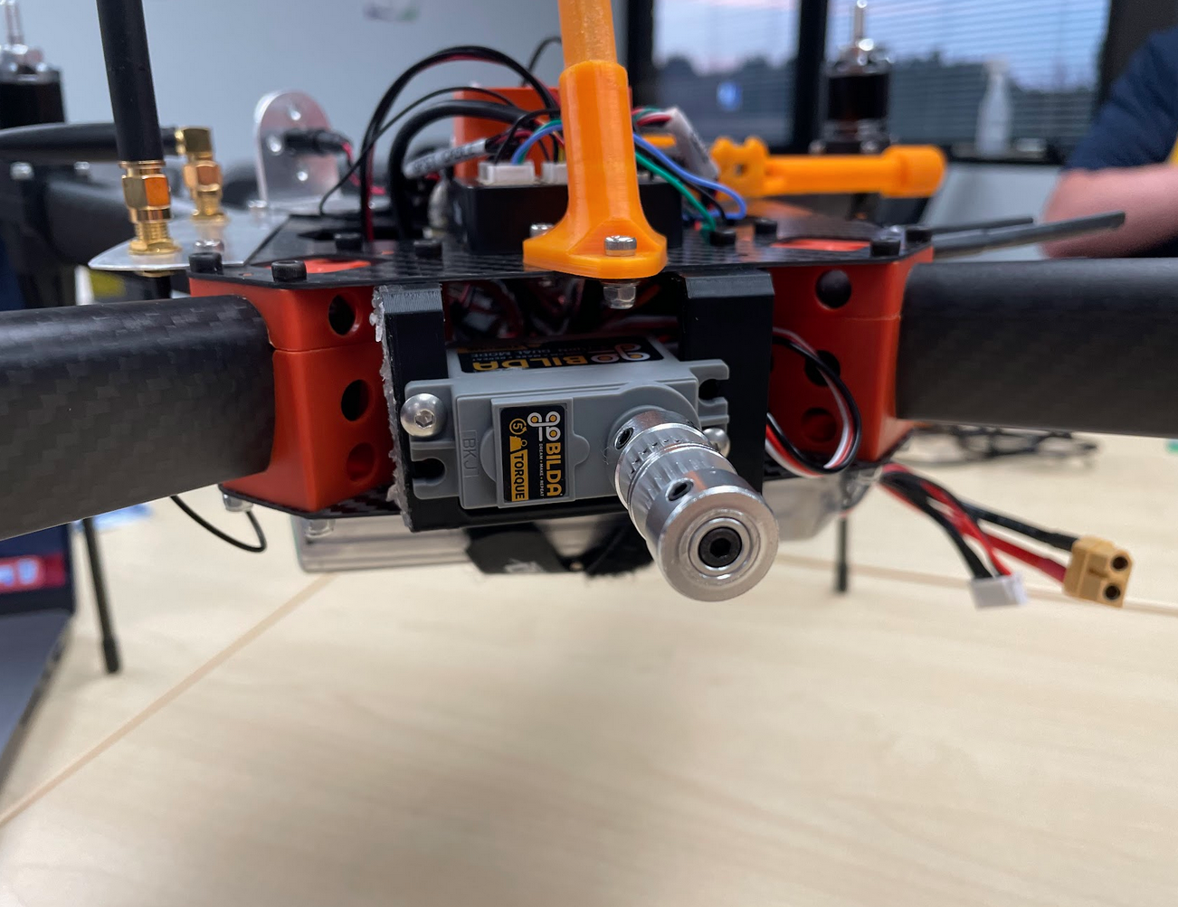
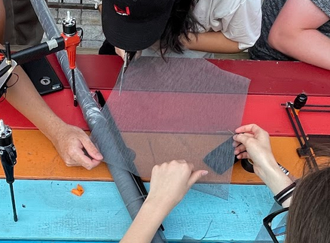
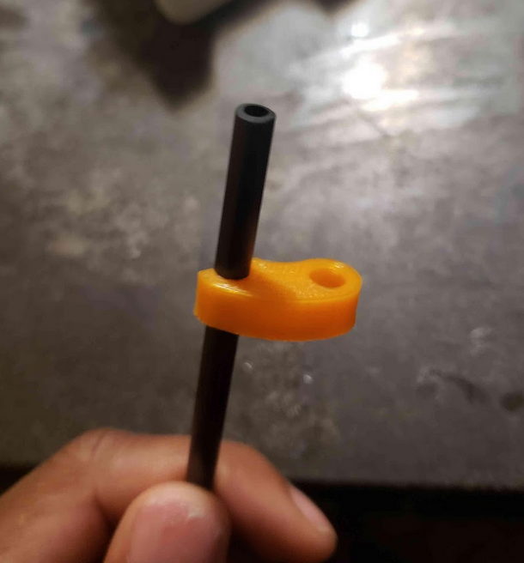
Developmental Test - Corrective Actions Taken (cont’d)
Cable grommet
Clips added to reduce flexing
Adjustable servo mount
Changed tablecloth material
Leg replacements
Added second belt for more grip
Notes:
Bobby (?)
In order to mount the RTMT onto the quad, we used cable grommets. This way, the system would be securely fitted to the legs while also being removable in the case we need to make adjustments.
We added clips to reduce flexing in the carbon fiber tubes while the servo was running. This way, we reduce the chance of the servo skipping while running.
We also designed an adjustable servo mount to give us flexibility and ensure that there is sufficient tension in the belt drive.
We also changed our tablecloth mesh because in our earlier prototypes, we used a thicker mesh that often resulted in the mechanism becoming stuck after several rotations.
In our early tests, we found that the basic legs the kit came with were quite fragile, as the carbon fiber was extruded, rather than woven. We replaced these legs with stronger woven ones to reduce risk of damage.
2023 Rulebook (Advanced): https://drive.google.com/file/d/1Mi2_LH2hsYAbPQPS31GaID_NoeDhwebQ/view?usp=share_link
4.2.9.5. Developmental Test Results
Including: test plan schedule (through ground testing to flight testing to mission performance testing), results of testing, and any corrective action taken to improve the effectiveness on mission completion. (15%)
2023 notes
Sliding (ITPM) design
Initial cloth + cardboard prototype
Iterated on with changes to materials, size, etc.
2023 Rulebook (Advanced): https://drive.google.com/file/d/1Mi2_LH2hsYAbPQPS31GaID_NoeDhwebQ/view?usp=share_link

Slide 21
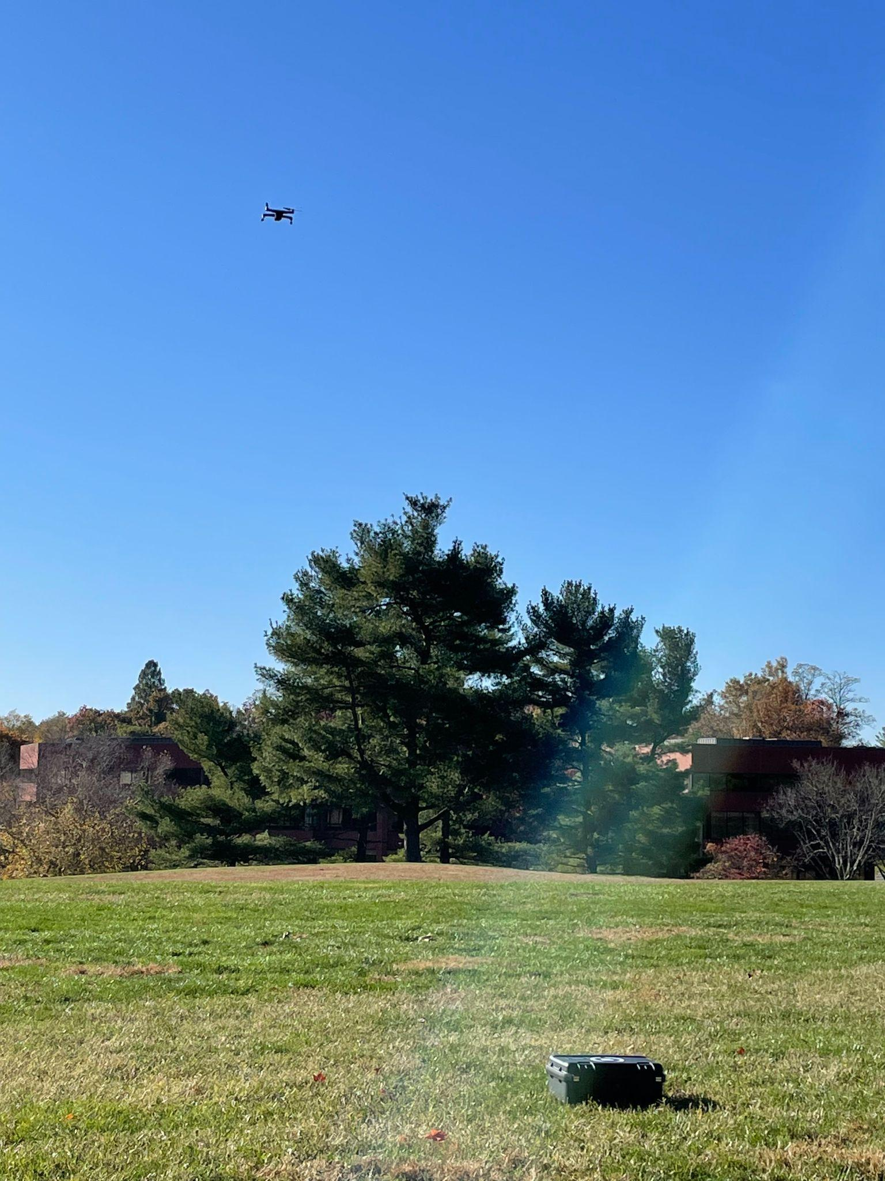
Evidence of Mission Accomplishments
Payload grabber that has transported all 3 payloads
Trained A.I. to recognize targets
Safety protocols effectively ensured no damage to persons or property
Team members effectively executed assigned roles
Notes:
Lindsay
We created a payload grabber that has been able to pick up and carry all 3 payloads during testing inspired by our successful design last year. Also, we have trained an AI to recognize the targets. In the future, we plan on implementing this AI to further increase the level of autonomy. Additionally, by having our team members executing specific roles and use safety protocols, we have ensured no damage to anyone or anything.
2023 Rulebook (Advanced): https://drive.google.com/file/d/1Mi2_LH2hsYAbPQPS31GaID_NoeDhwebQ/view?usp=share_link
4.2.9.6. Evidence of Mission Accomplishments.
Show the judges what you have achieved. (10%)
- <5 ft is a recent improvement (even in wind and other factors)

Slide 22
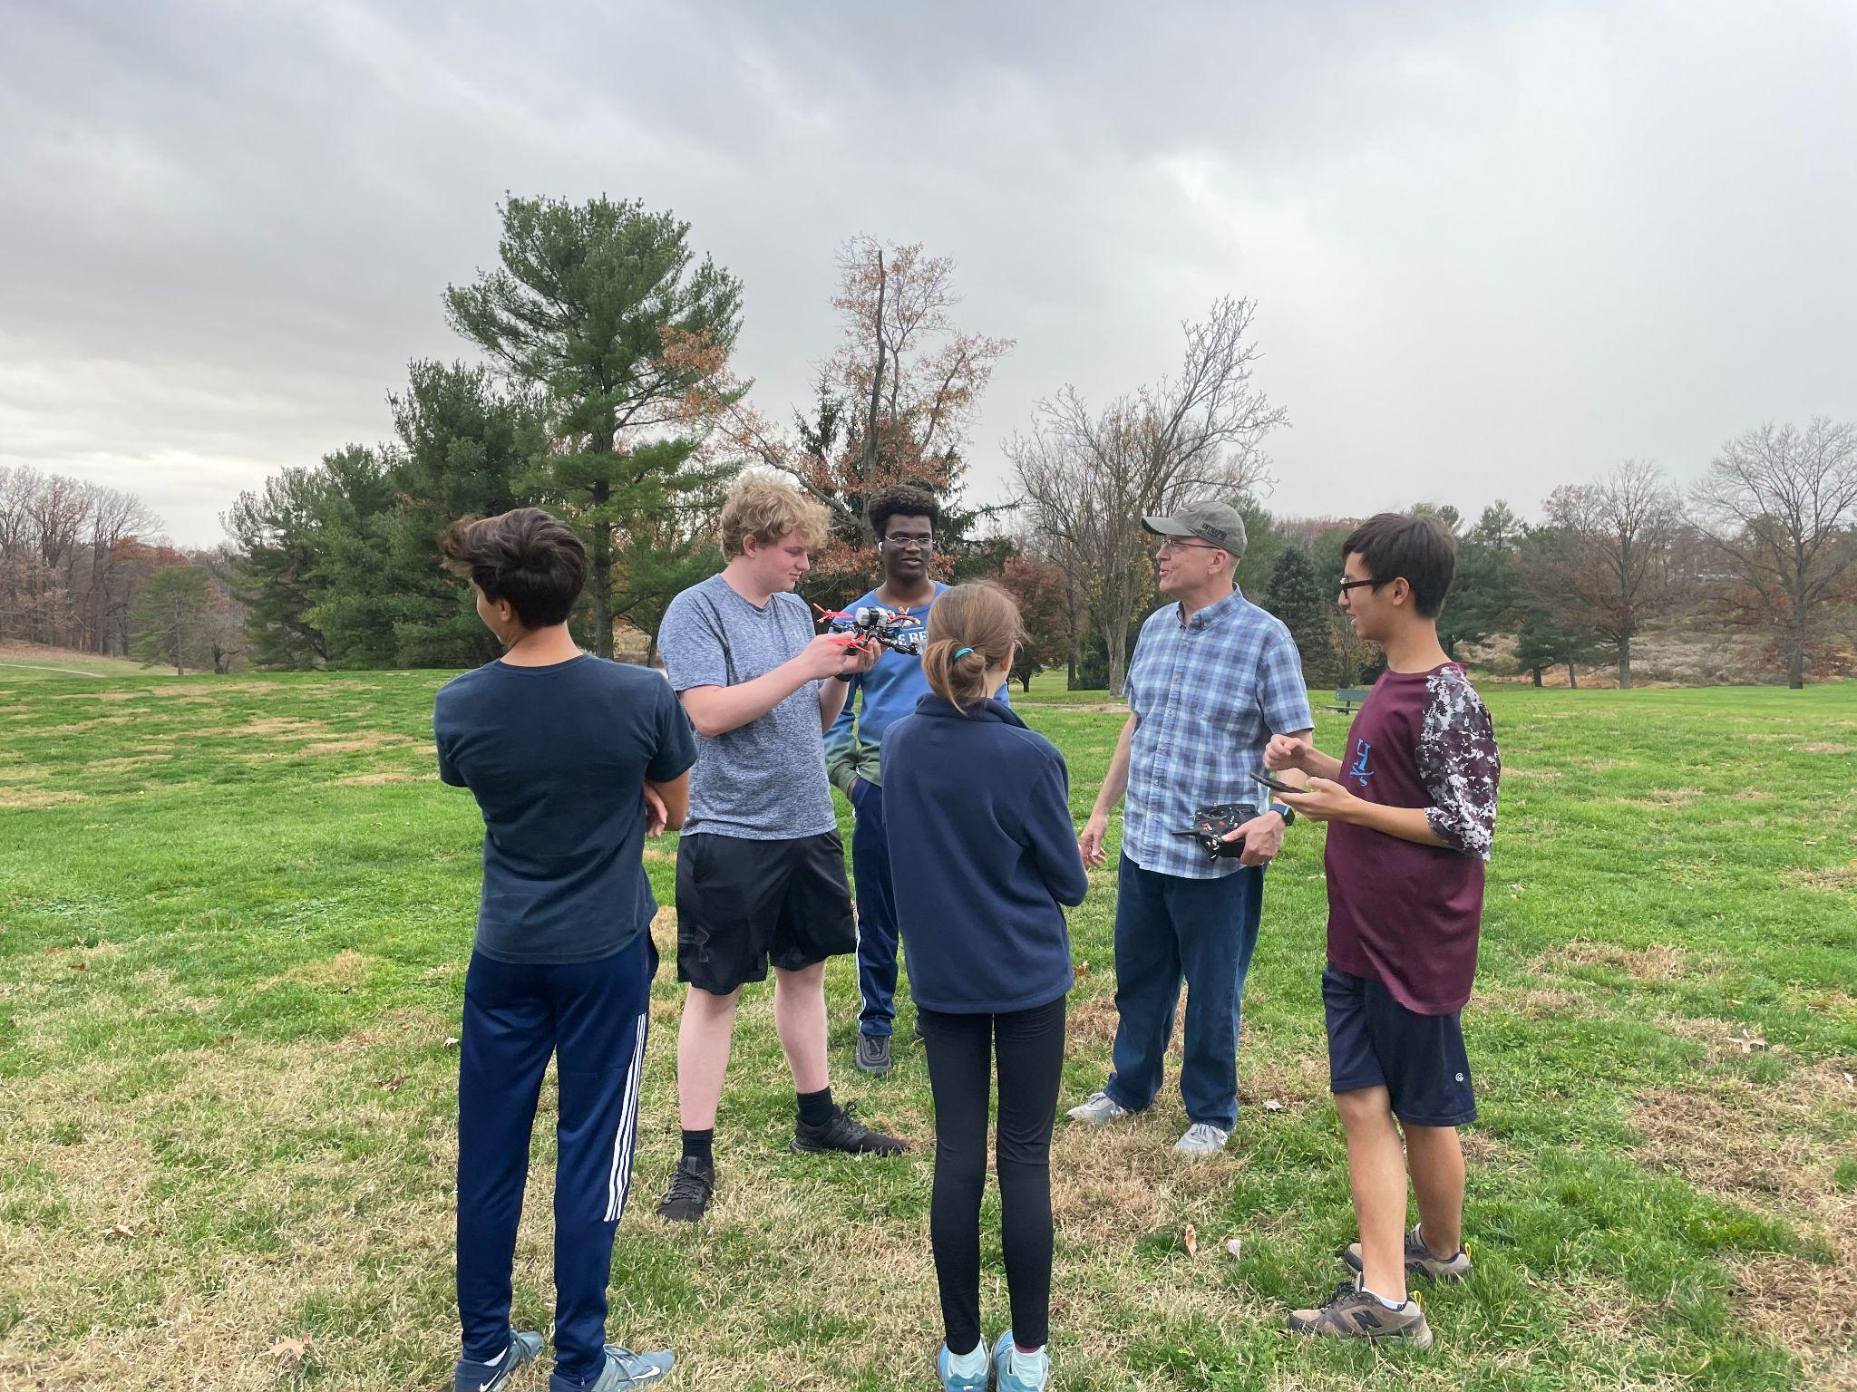
Pre-Mission Briefing - Personnel Resourcing
Defined responsibilities based on roles
Roles assigned based on skills and interests
Allocated positions and tasks based on flight vehicle condition
Grounded-preflight
Flying
Grounded-post flight
Notes:
Jasmine
For personnel resourcing, we defined mission responsibilities based on the designated roles for each team member. These roles were assigned based on everyone’s prior skills and interests to make the mission experience more streamlined and more fun for everyone!.
Also, we allocated positions and tasks based on the flight vehicle condition; for example, the mission planner specialist will enter data into MP commands when the quad is grounded. However, when the quad is flying, they will capture the coordinates of the quad and control the grabber servo. Essentially, someone’s roles when the quad is grounded is going to be different from when the quad is actively flying a mission.
2023 Rulebook (Advanced): https://drive.google.com/file/d/1Mi2_LH2hsYAbPQPS31GaID_NoeDhwebQ/view?usp=share_link
4.2.9.7. Pre-Mission Briefing
Including personnel resourcing for the flight, communication procedures, and go/no-go criteria. Judges will pose a hypothetical question to gather a teams sense of fallback plans should a technical issue arise during flight mission. (10%)

Slide 23
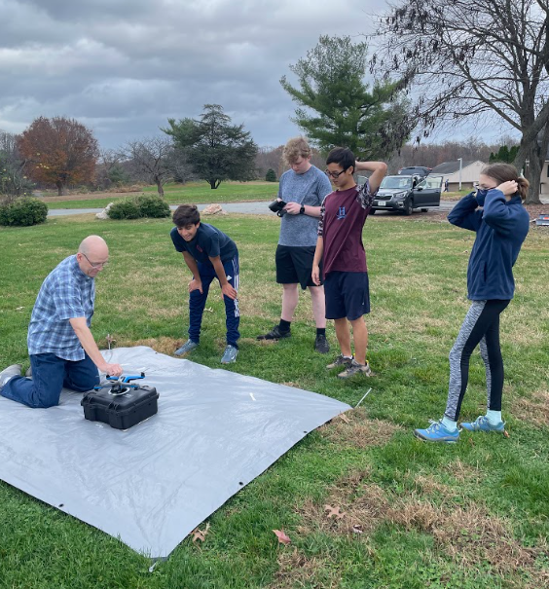
Pre-Mission Briefing - Team Comms
Maintaining communication with team roles:
All non-essential activities are forbidden (sterile cockpit)
Share essential information
Each role has specific call outs
Maintain records of each flight
Notes:
Theo
Communication is extremely important during missions, and we take steps to ensure that all communication is clear and concise. We hold the sterile cockpit rule so that everyone stays focused and isn’t distracted, and make sure to only share essential information so as to not clutter up the flight area. Each role has specific call outs so that we know who should be receiving specific information and can pay attention (for example, if Nathan sees a target on the monitor then he will call that out to Veronica to draw it on the map without confusing other people). We also maintain records of each flight so we can evolve and develop our strategies.
2023 Rulebook (Advanced): https://drive.google.com/file/d/1Mi2_LH2hsYAbPQPS31GaID_NoeDhwebQ/view?usp=share_link
4.2.9.7. Pre-Mission Briefing
Including personnel resourcing for the flight, communication procedures, and go/no-go criteria. Judges will pose a hypothetical question to gather a teams sense of fallback plans should a technical issue arise during flight mission. (10%)
Link to manned aviation
The process of searching for targets also an example, Lucas tells Visesh which targets to direct Muhammed too, and Lucas shouts altitude and David tells Visesh how to move once over the target

Slide 24
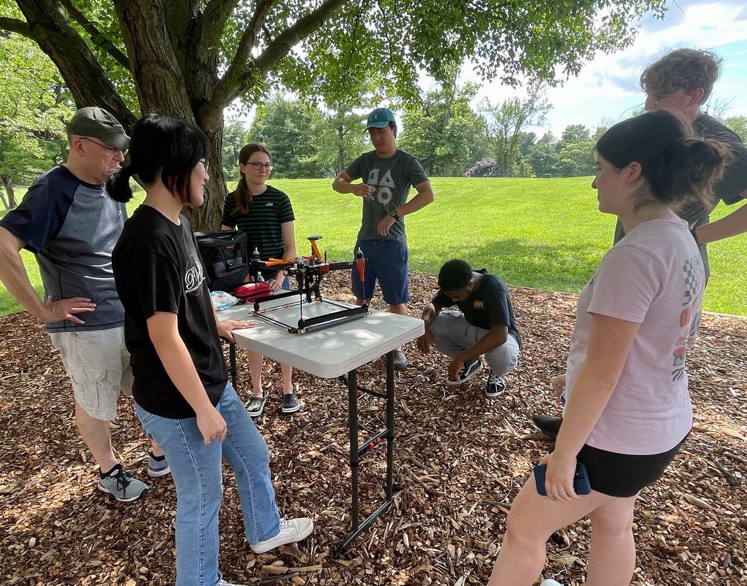
Pre-Mission Briefing - Go/No-Go Criteria
Discussions and briefings include:
Before Flight
Weather
Airspace Activity
Presence of people
Condition of Quad
During Flight
Aircraft Performance
Wind Speed
Battery Condition
Airspace Activity
Notes:
Ethan
Talk about our regular safety practices including establishing the flight line, “all eyes on the quad’, safety equipment (fire extinguisher and first-aid kit).
For our go/no-go criteria, we always keep safety in mind. Again, we will never fly in bad weather.
Since we fly at a local park, there are many factors that we must consider. For example, there may be people or animals in the area which we must be careful of, or other people may be flying their own recreational drones, which would mean that any airspace activity must be considered both before and during the flight
While the quad is in the air, we constantly monitor the aircraft’s performance, wind speed, and battery condition through mission planner and observations. In the case of any surprise emergencies, such as high winds, low battery voltage, or an observed issue with the quad, we will immediately RTL.
2023 Rulebook (Advanced): https://drive.google.com/file/d/1Mi2_LH2hsYAbPQPS31GaID_NoeDhwebQ/view?usp=share_link
4.2.9.7. Pre-Mission Briefing
Including personnel resourcing for the flight, communication procedures, and go/no-go criteria. Judges will pose a hypothetical question to gather a teams sense of fallback plans should a technical issue arise during flight mission. (10%)
Safety is a critical part of any flight. To maintain safety, the team conducts discussions and briefings regarding go/no-go criteria. This is some of the things discussed both before flight and during flight

Slide 25
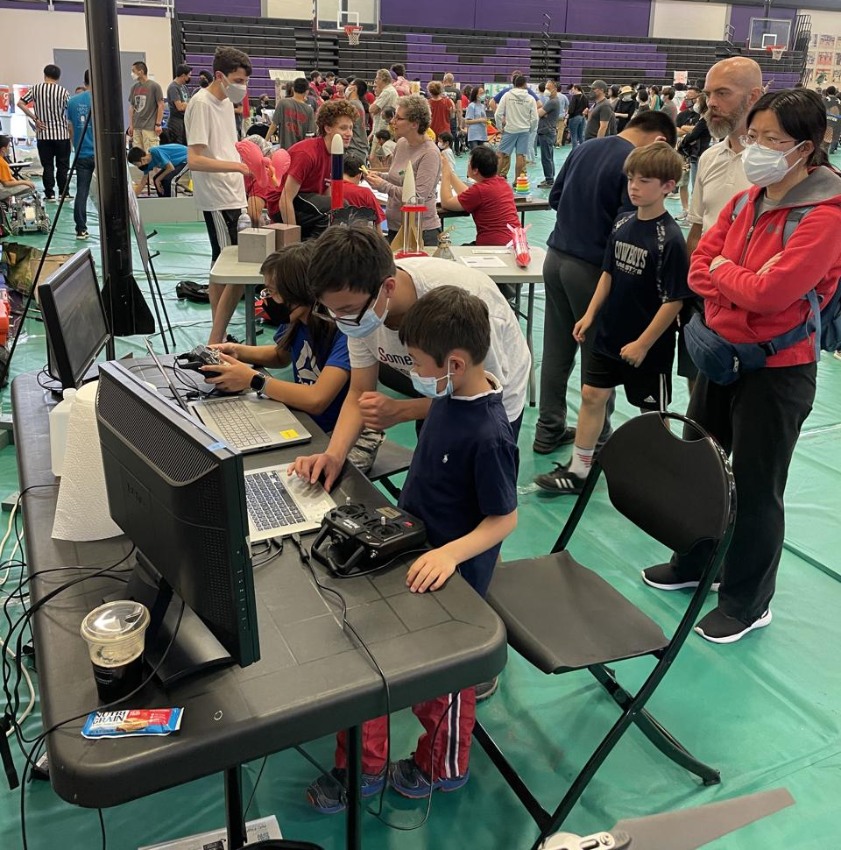
Social Outreach
Local science day event
Introduce community to drones/explorer post (flight simulators)
Explorer Post picnic
Fundraising event, demos for the public (Skydio drone and flight simulators)
SciTech2U
Notes:
NATHAN
Rockville Science Day - 4k+ people attended
Fundraising - Over 4k dollars
Mention personal proj
What is personal project? Do we have any?

Slide 26
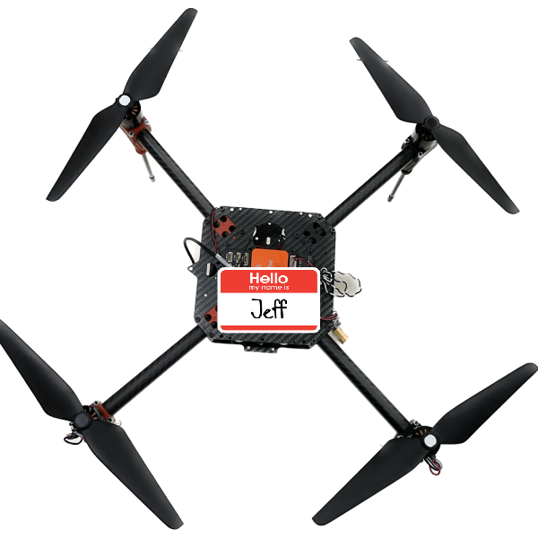
Thank you for your time!
Questions?
Notes:
All: 3…2…1… “Thank You!”
2023 Rulebook (Advanced): https://drive.google.com/file/d/1Mi2_LH2hsYAbPQPS31GaID_NoeDhwebQ/view?usp=share_link
4.2.5. Following the FRR briefing, there will be a question-and-answer period with the judges and a mission-planning software assessment. Five verbal questions from the judges will be presented and worth one point each.
4.2.9.8. Participation and communication skills will be scored by judges factoring in aspects such as clarity, accuracy, logic, precision, relevance, depth, and suitability. Five judges questions will also be posed prior to the mission-planning software assessment. (5%)
4.2.9.7. Pre-Mission Briefing
Including personnel resourcing for the flight, communication procedures, and go/no-go criteria. Judges will pose a hypothetical question to gather a teams sense of fallback plans should a technical issue arise during flight mission. (10%)

Slide 27
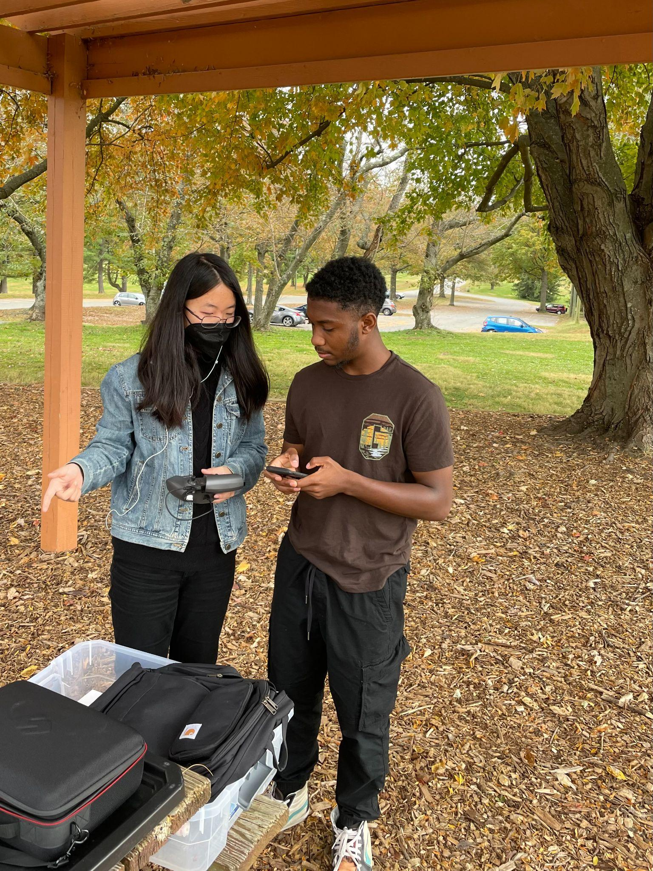
System Safety - Maintenance and Checklists
We use checklists to enforce safety
Pre-flight
Post-flight
We inspect all aircraft parts before each flight
Repairs are made with consent from all team members
Notes:
Nathan
2023 Rulebook (Advanced): https://drive.google.com/file/d/1Mi2_LH2hsYAbPQPS31GaID_NoeDhwebQ/view?usp=share_link
4.4.6.2.3 System Safety with identified design and operational strategies (10%)
Lucas
Improvements - Go into detail about checklists hear, either verbally, detailed slides, or additional slide

Slide 28
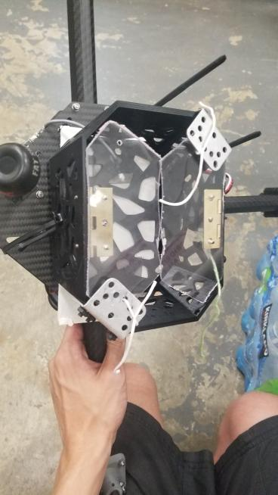
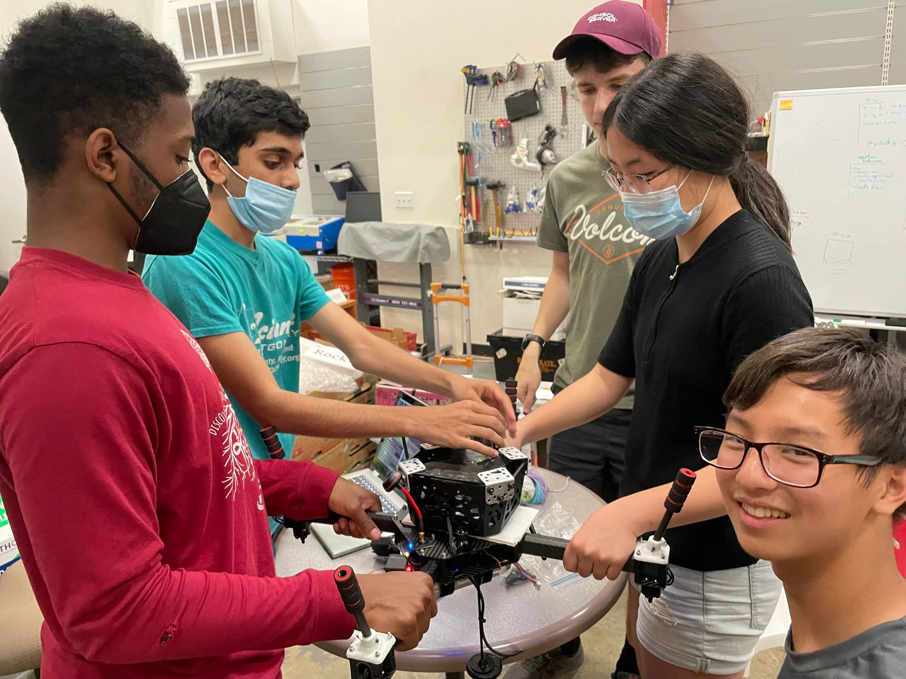
Developmental Test - Initial Results
Goal: Expand the “flight envelope” to address all aspects of the competition flight tasks
Discoveries:
High amp draw (>20 A)
Pickup Attempts knocked over payload
Inexact landing due to offset camera position
Developed criteria for new design
Notes:
Visesh
2023 Rulebook (Advanced): https://drive.google.com/file/d/1Mi2_LH2hsYAbPQPS31GaID_NoeDhwebQ/view?usp=share_link
4.4.6.2.4
Incrementally expand the flight envelope (starting from testing before flight…)
Discoveries:
High amp draw (>20 A)
Burnt one motor
Heavy grabber weight due to bulky metal/plastic structure
Pickup Attempts knocked over payload
Grabber knocked over payload due to translational velocity
Developed criteria for new design:
Active grabbing system
Lightweight
Larger margin for error

Slide 29
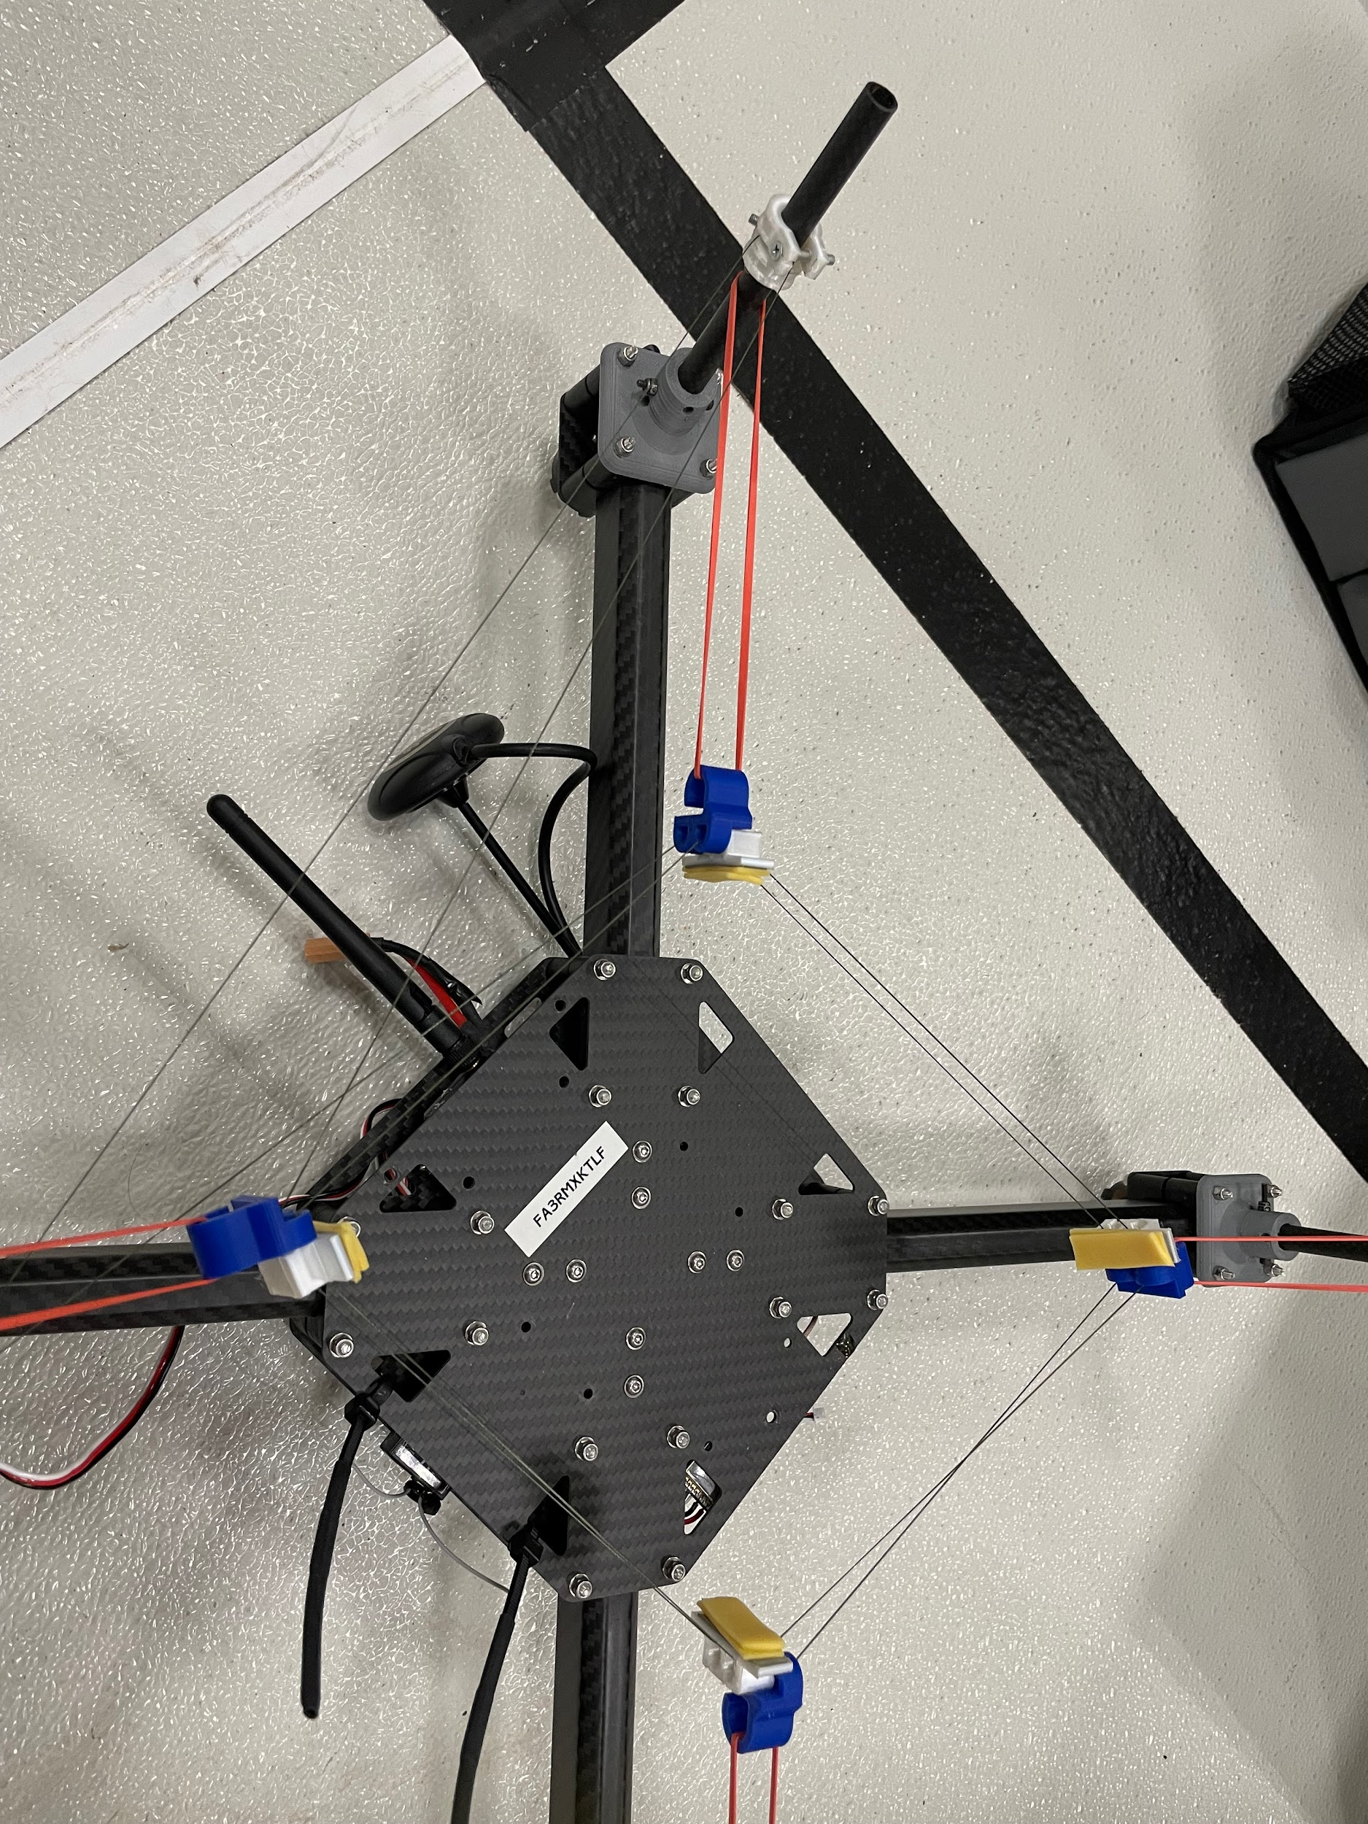
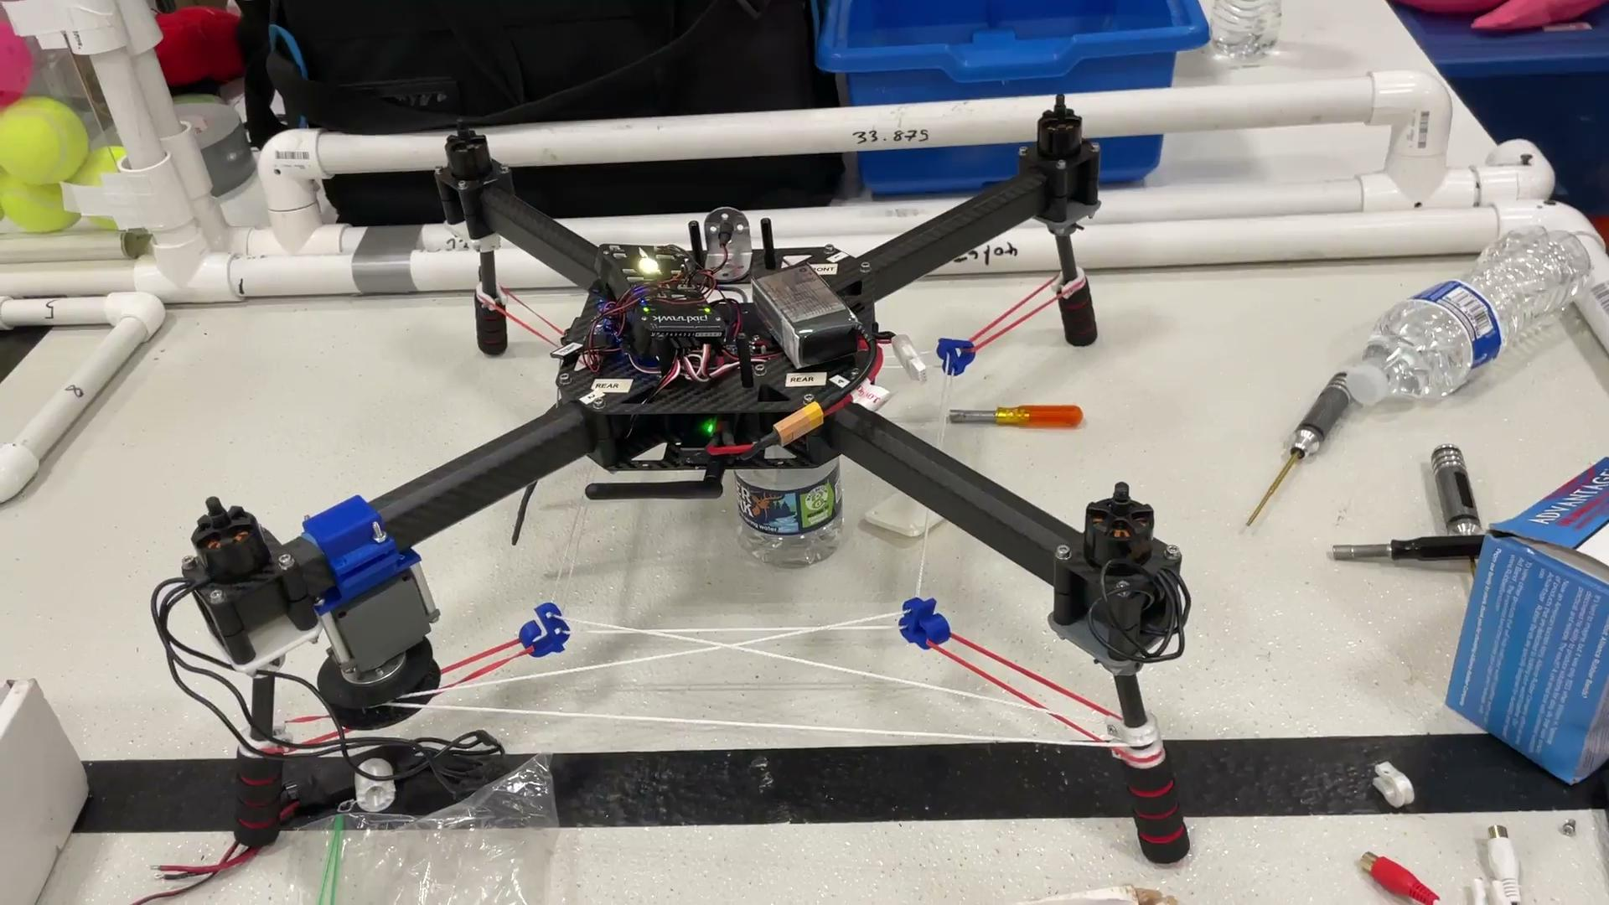
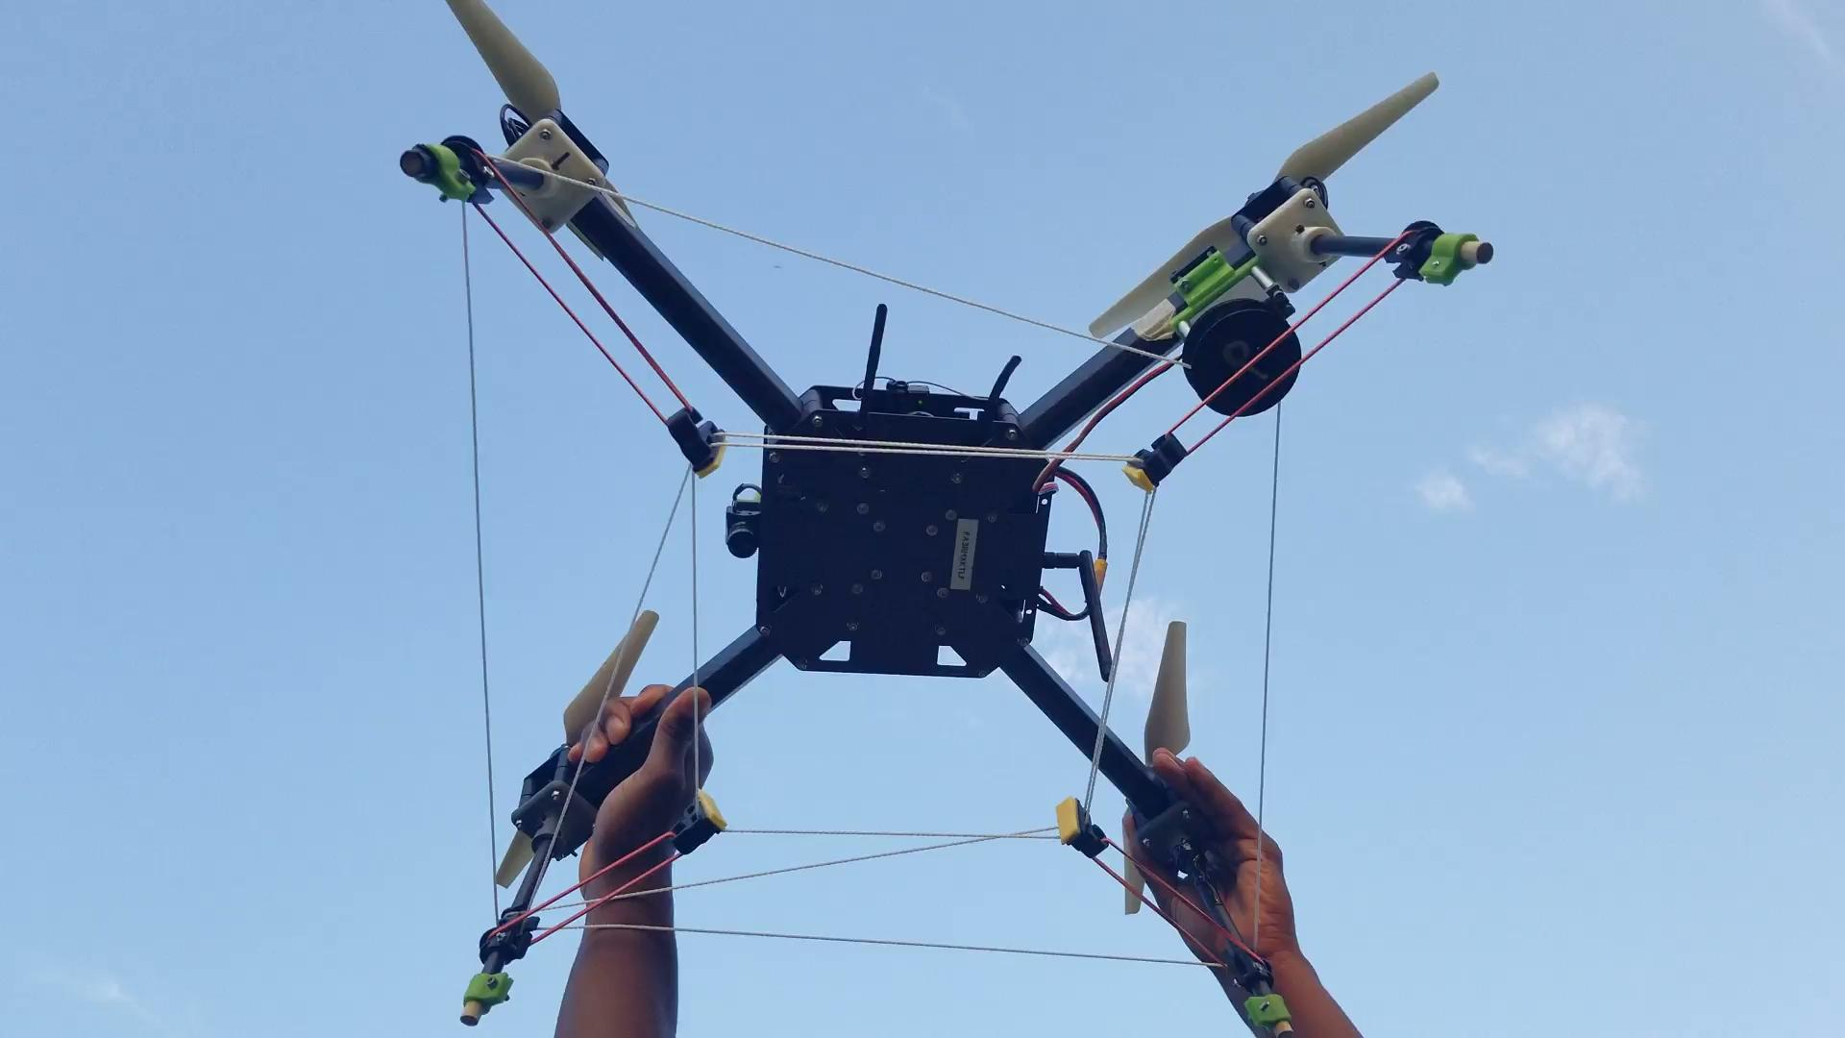
Developmental Test - Design Progression
Different string types Warp thread Fishing line Rubber band types | Servo mounts Extended legs Guiding clamp designs and features Rubber pads = less compression
Notes:
2023 Rulebook (Advanced): https://drive.google.com/file/d/1Mi2_LH2hsYAbPQPS31GaID_NoeDhwebQ/view?usp=share_link

Slide 30
Introductions and Flight Mission Roles
Muhammed | Safety Pilot/Pilot in Command
Nathan | Scoring Captain
Ethan | A.I. Developer
Jasmine | Mission Planner Specialist
Bobby | Aircraft Specialist
UPDATE!
Notes:
ALL
Name, grade, school, years on team, why you joined
2023 Rulebook (Advanced): https://drive.google.com/file/d/1Mi2_LH2hsYAbPQPS31GaID_NoeDhwebQ/view?usp=share_link
4.2.9.1. Team Member Introductions
Including flight mission roles and experience for all team members. (5%)
Speaker notes : we communicate with each other to make sure
We present our own roles, what experience
Everyone participates here
Scoring captain - monitor dude
Other roles:
Video producer
3d printing specialist
Payload specialist (resetting, maintenance, design)

Slide 31
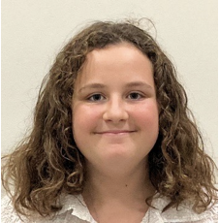
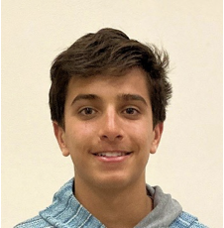
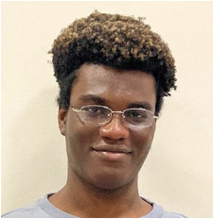
Introductions and Flight Mission Roles (cont’d)
Sam | Safety Specialist
Julian | Air Boss
Theo | Video Producer/Co-Pilot
Veronica | Strategic Technician
Lindsay | Co-Strategic Technician
UPDATE!
Notes:
ALL
Name, grade, school, years on team, why you joined
2023 Rulebook (Advanced): https://drive.google.com/file/d/1Mi2_LH2hsYAbPQPS31GaID_NoeDhwebQ/view?usp=share_link
4.2.9.1. Team Member Introductions
Including flight mission roles and experience for all team members. (5%)
Speaker notes : we communicate with each other to make sure
We present our own roles, what experience
Everyone participates here
Scoring captain - monitor dude
Other roles:
Video producer
3d printing specialist
Payload specialist (resetting, maintenance, design)

