Slide 1
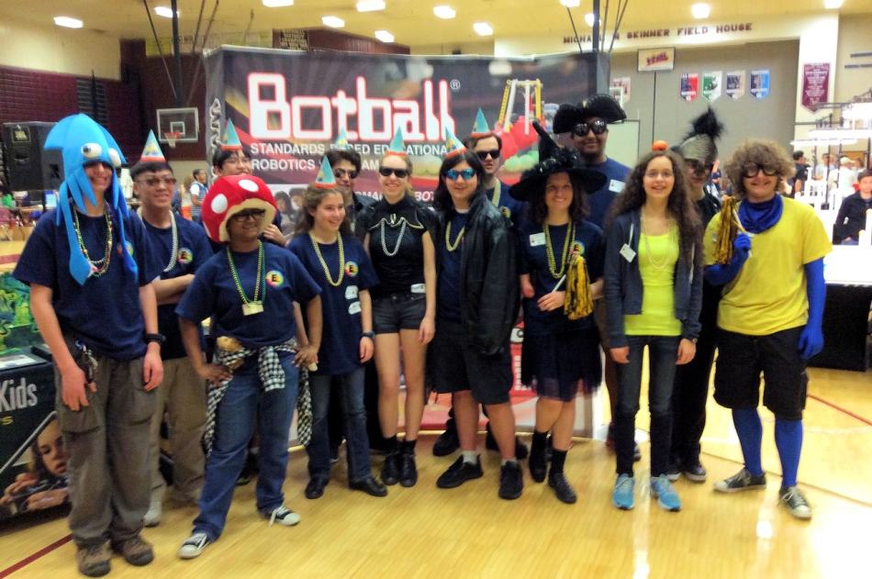
Engineering Exploring Program
Explorer Post 1010
Rockville Maryland
Bob Ekman, Advisor
September 2020

Slide 2
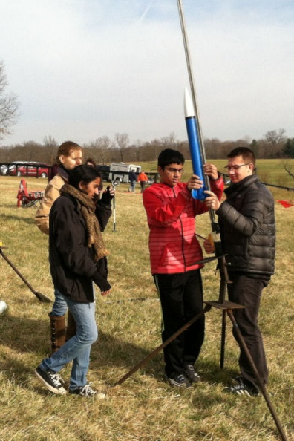
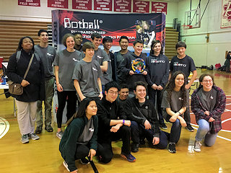
Who We Are
Enthusiastic students from local high schools, interested in engineering
Sponsored by the Rockville Science Center
Organized under national
Exploring Program,
Learning for Life,
Boy Scouts of America Affiliate

Slide 3
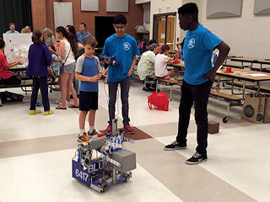
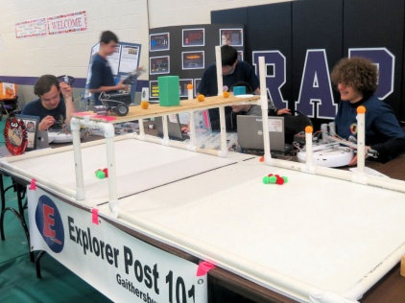
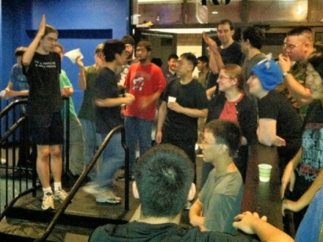
What We Do (Discover Your Future)
Compete in international robotics,
rocketry and drone programs
Everyone on a team
Teen leadership responsibilities
Local field trips and presentations
Community service opportunities
Adult support
And we have a lot of fun!

Slide 4
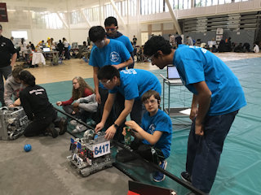
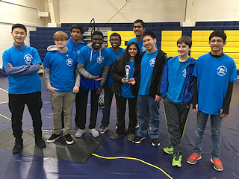
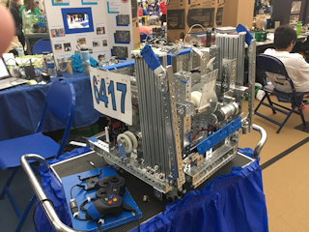
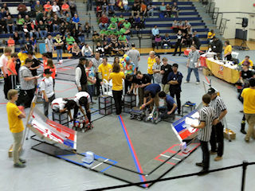
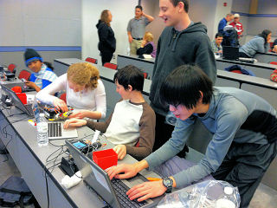
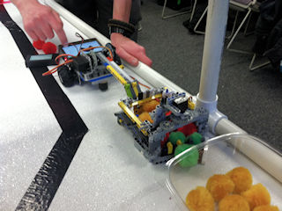
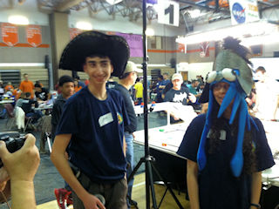
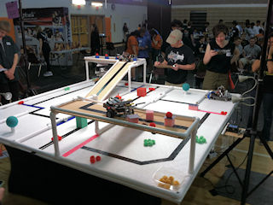
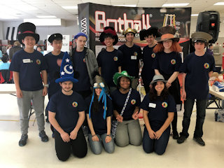
We Kick Bots!
FIRST Tech Challenge
  One team in 2018/2019
  Awards in local tournaments, state finals
  New challenge for 2020/21
Botball Educational Robotics
  Twenty years participation
  Compete in DC region tournaments, participate in global competition
  Regional and global awards over many years
  2020 challenge extended to 2021

Slide 5
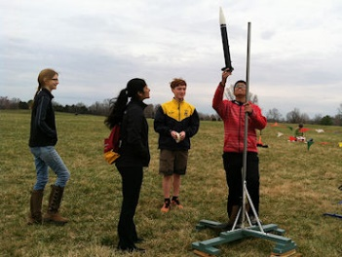
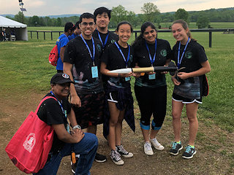
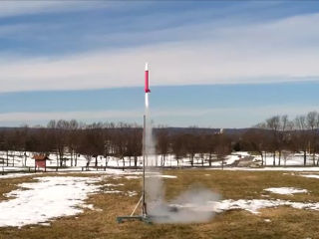
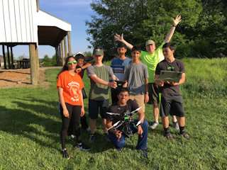
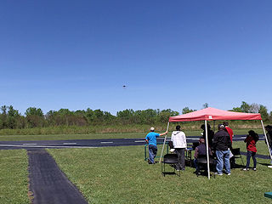
We Fly Them High!
The American Rocketry Challenge
  Design/build model rockets to meet a specific
  altitude, duration, design, and recovery
  Carry eggs and altimeter
  Launch in MD and VA
  Best teams in Maryland in 2019
  2020 challenge extended to 2021
Unmanned Aircraft Systems (UAS)
  Build and fly a quadcopter to complete a detailed mission
  2019 went to national competition
  2020 challenge extended to 2021

Slide 6

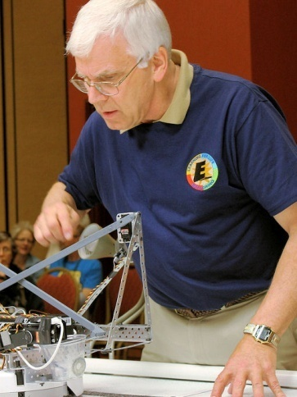
Operations
Membership 2020
  40 high school girls and boys
  From many different schools
  90% graduate to science/engineering
  higher education degree programs
Meetings
  Wednesday, on-line 7pm – 9pm, everyone
  Varied in-person work sessions
  Saturday/Sunday launches, competitions
  Annual picnic, teamwork events
  Exhibits, school visits, SSL opportunities
  Local tours, summer overnight trips

Slide 7

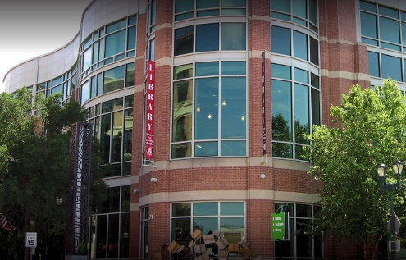
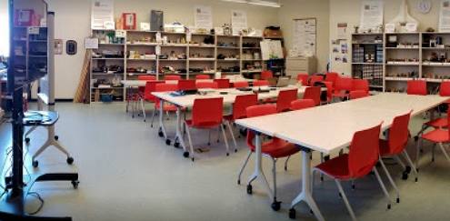
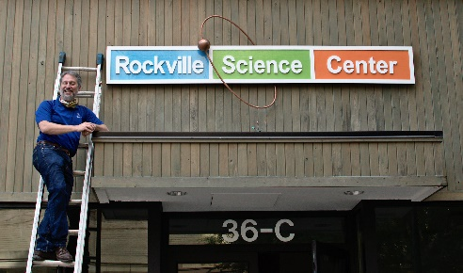
Rockville Science Center Sponsorship
Explorer Post 1010 in 23rd year
  Seventeen years at Lockheed Martin
  Five years at Johns Hopkins
Rockville Science Center Support
  Volunteers, mentors, resources, outreach
  Storefront at Rockville Town Square
Rockville Memorial Library
  Facility use, safe and secure location
Funding
  Dues ($200 annual)
  Grants, contributions
  Fund raising

Slide 8


Exploring (Learning for Life)
National organization
  Strives to be the foremost co-educational youth program for character and career development
  http://www.learning-for-life.org/
Exploring is work site career program
  Provides high school teens with environment, resources, and relationships they need to learn and grow
  Aviation, Business, Communications, Engineering, Fire Service, Health, Law Enforcement, Law & Government, Science
  30 Posts in DC area council, 900 students

Slide 9
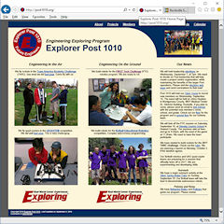
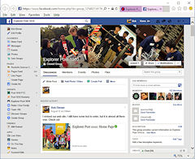
Contact
Advisor: Bob Ekman
  Rockville Science Center
  at Rockville Memorial Library and RSC Storefront
  21 and 36C Maryland Ave, Rockville, MD 20850
  301-512-1278 (mobile)
  info@post1010.org
  bob.ekman@att.net
Web Page: www.post1010.org
Facebook: Explorer Post 1010
Google Calendar: http://www.post1010.org/calendar.html

